Slide 1

CPE 431/531 Chapter 4 – The Processor
Dr. Rhonda Kay Gaede

Slide 2
4.1 Implementation Basics
Performance Factors
Instruction Count
Cycle Time
CPI
A Basic MIPS Implementation
Simple subset: lw, sw, add, sub, and, or, slt, beq, j

Slide 3
4.1 Implementation Overview
All instructions begin the same way
_________________
___________________
____________________
Then, it depends on the instruction
lw
sw
add et.al.
beq

Slide 4
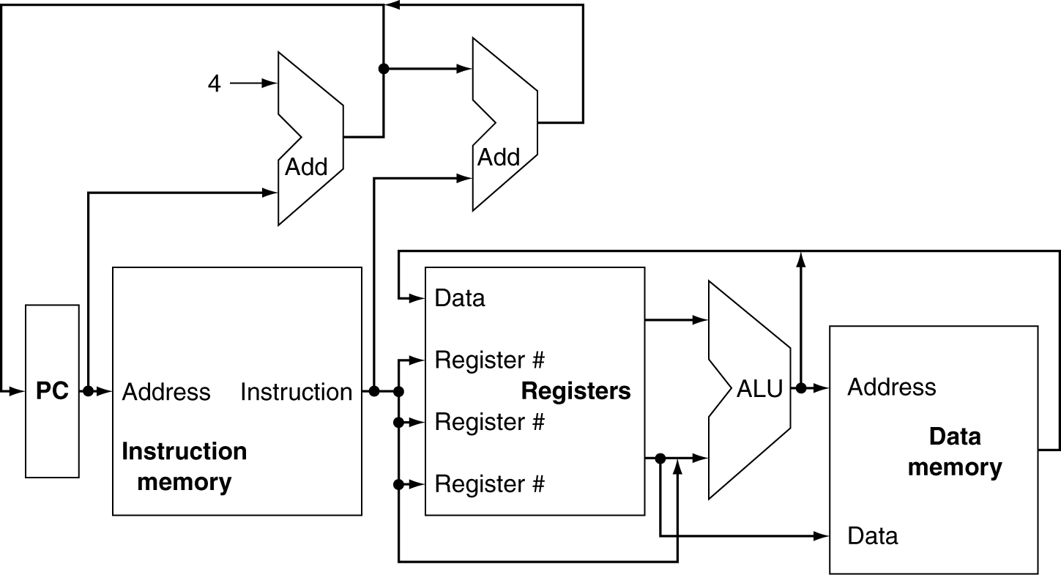
4.1 Datapath

Slide 5
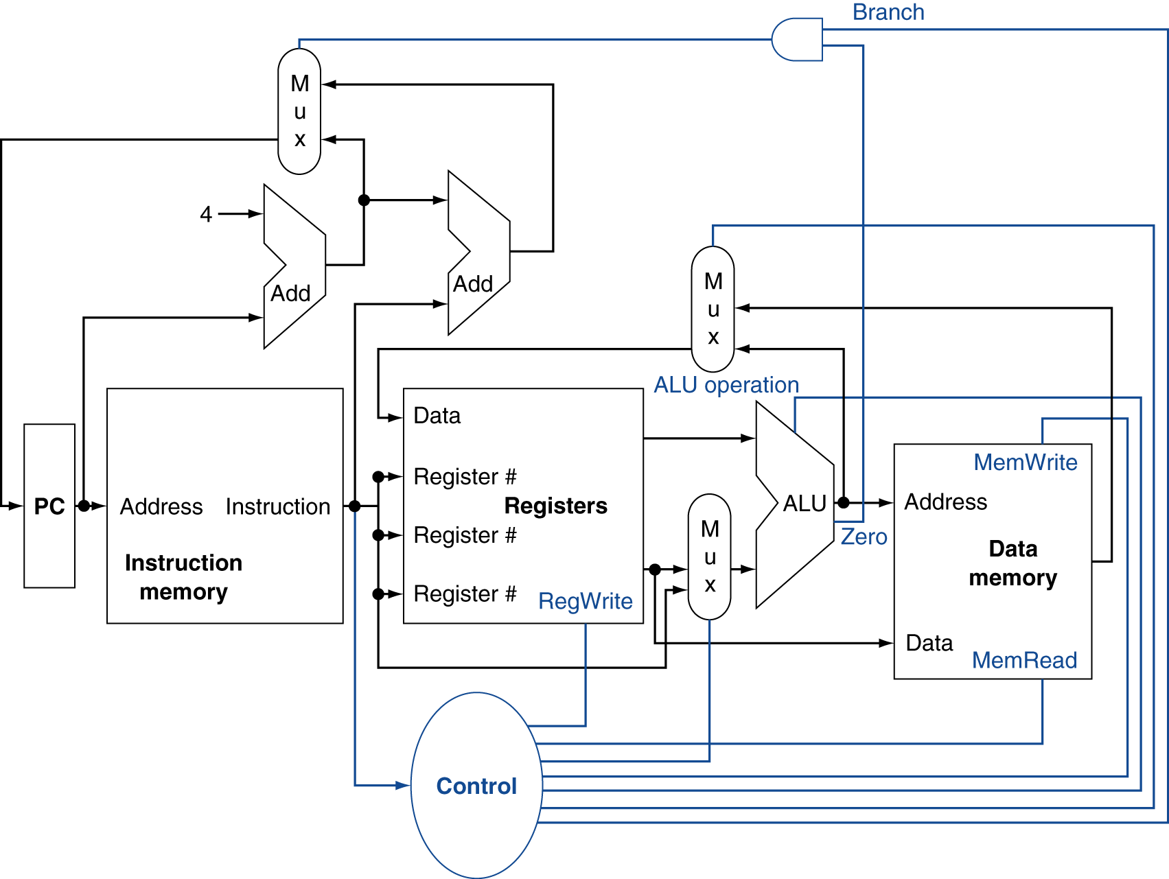
4.1 Datapath + Control

Slide 6
4.2 Classes and Values
Two classes of logic
___________
_______________l
Two logic values
___________
____________-

Slide 7
4.2 Sequential Elements
Register with write control
Only updates on clock edge when write control input is 1
Used when stored value is required later.
Clk
D
Q
Write
Write
Clk
D
Q

Slide 8
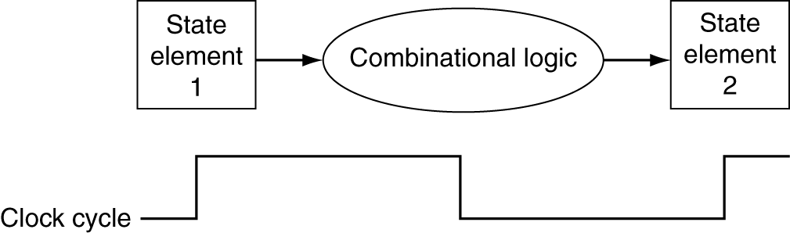
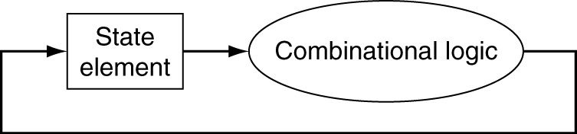
4.2 Clocking Methodology
A clocking methodology defines when signals can be _______ and when they can be _________.
We assume an ______________ clocking methodology.
Longest delay determines clock period

Slide 9
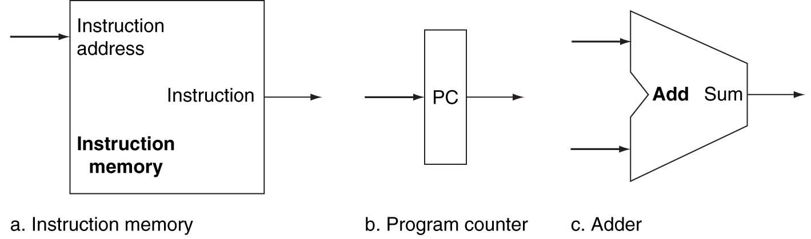
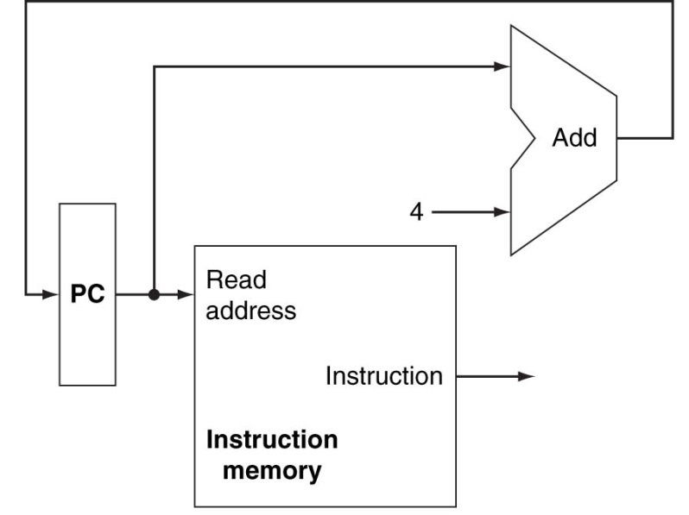
4.3 Instruction Fetch and Default Sequencing

Slide 10
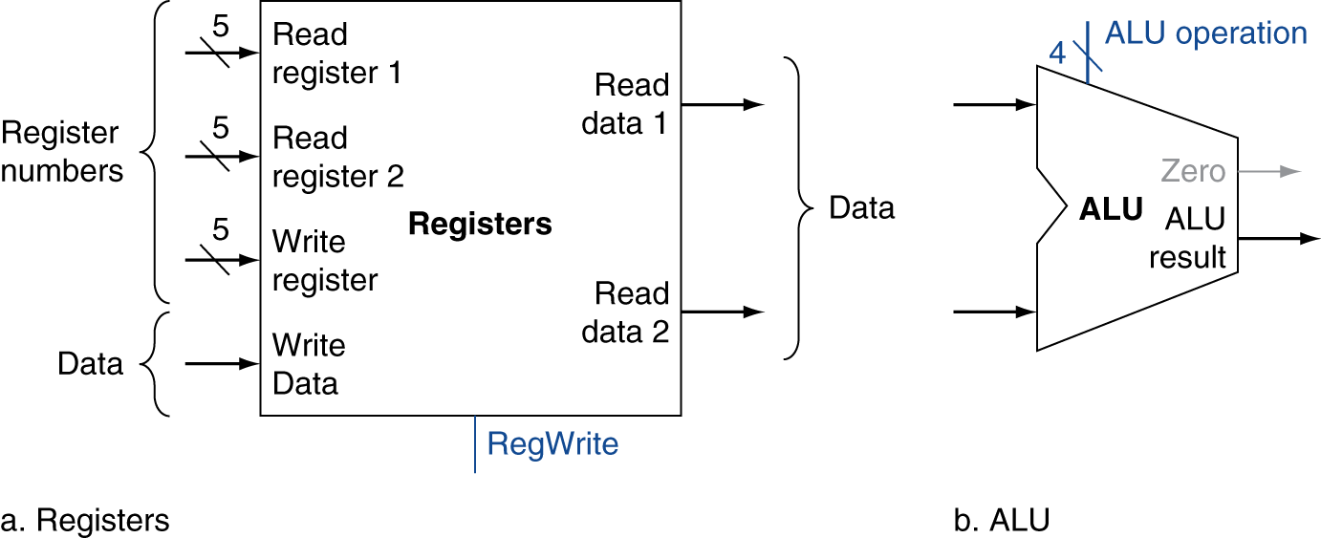
4.3 R-type Instruction Requirements
Read ____ register operands
Perform ______________ operation
______ register results

Slide 11
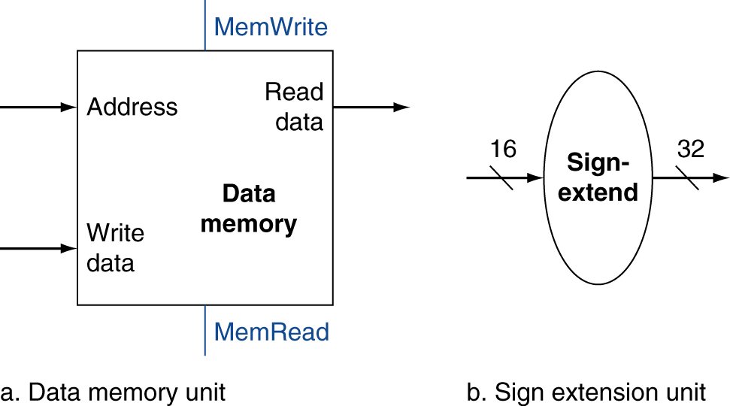
4.3 lw/sw Instruction Requirements
Read register operands
Calculate _________ _______ using 16-bit offset
Load: ______ memory and _______ register
Store: _______ register value to ________

Slide 12
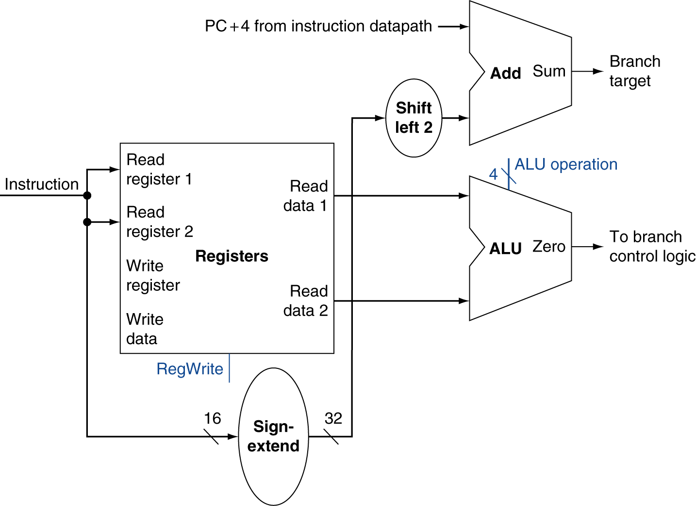
4.3 beq Instruction Requirements
Read register operands
_________ operands
Calculate ______ _________

Slide 13
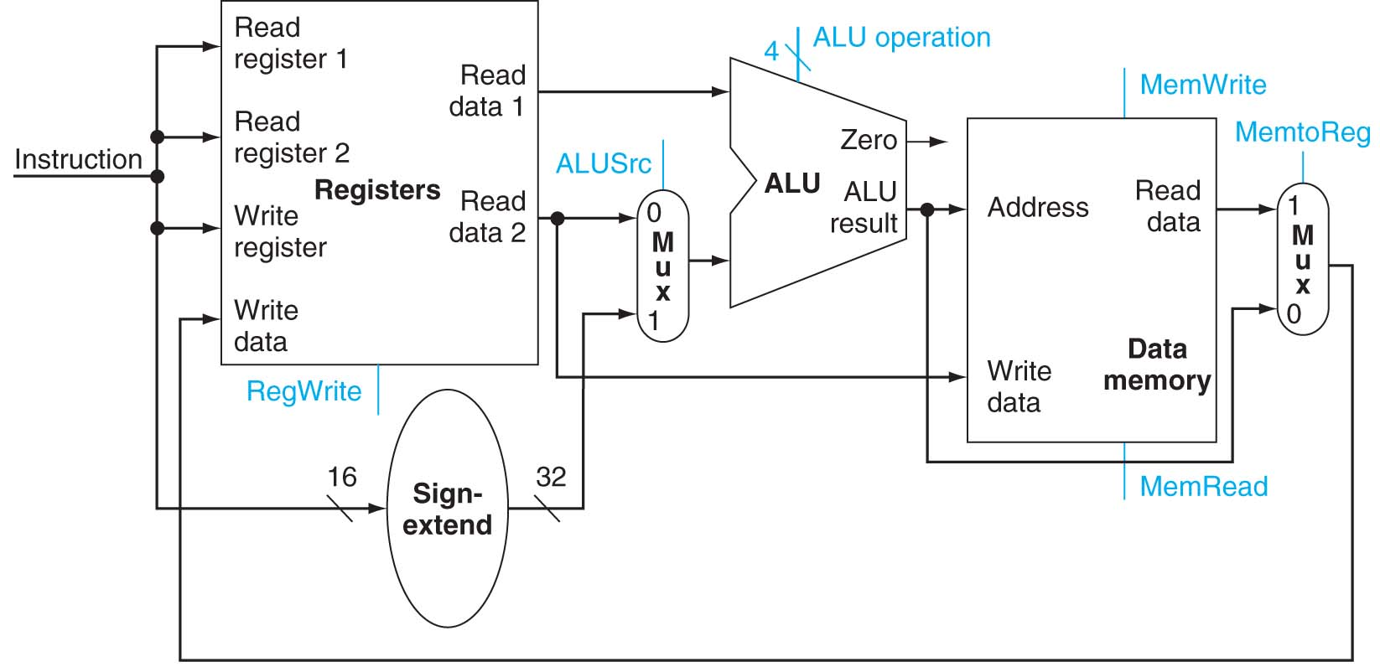
4.3 Creating a Single Datapath: R-type + lw/sw
We want a ___________ implementation.
Separate ____________ and ____ memories are required.
When I say _________, you say ____.

Slide 14
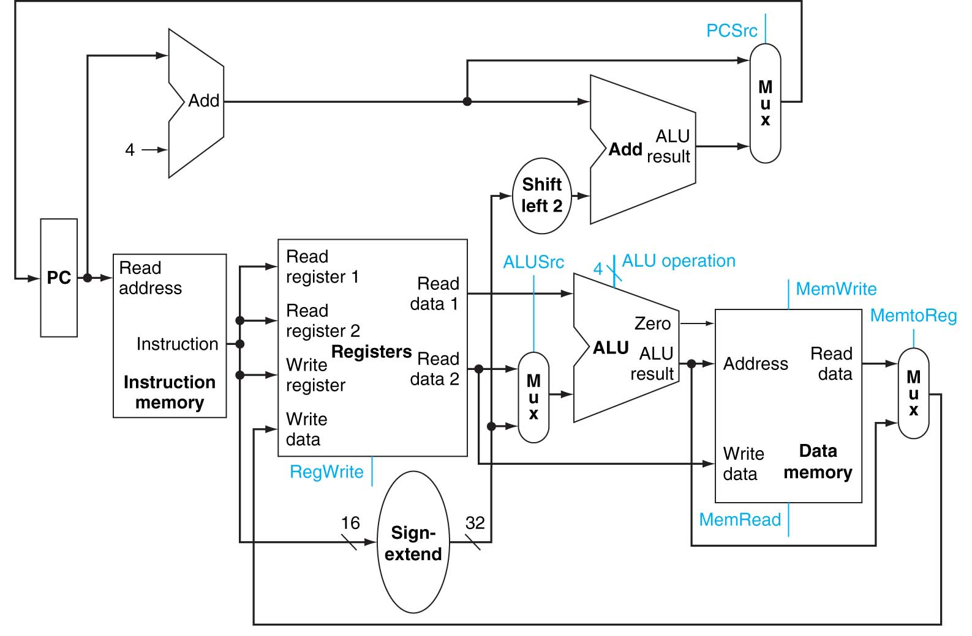
4.3 Adding beq to the R-type + lw/sw Datapath

Slide 15
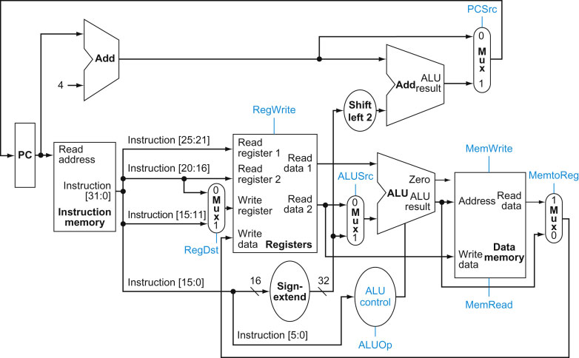
4.4 Defining Necessary Control

Slide 16
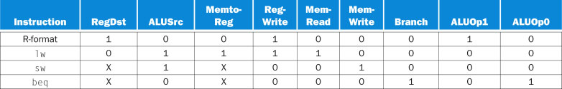
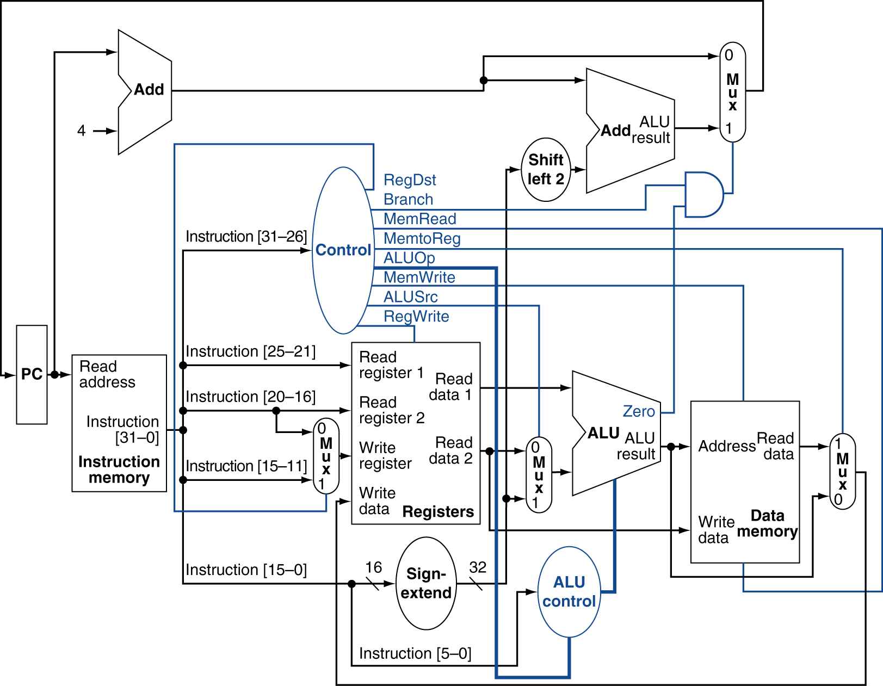
4.4 Adding a Control Unit

Slide 17
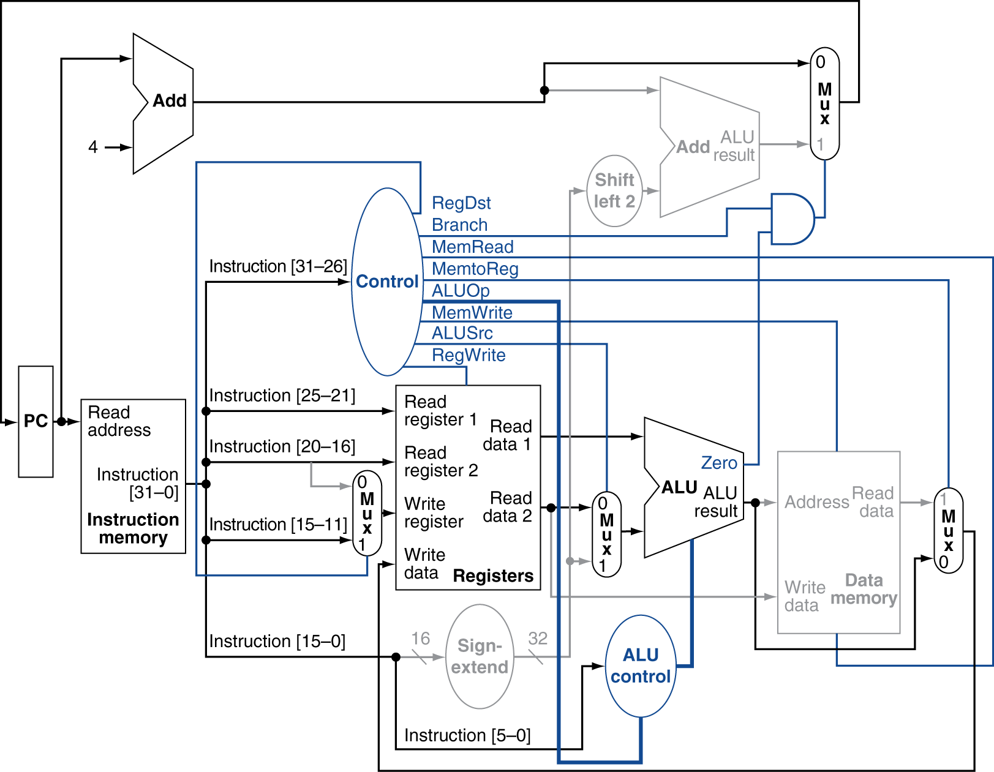
4.4 R-type Instruction Execution

Slide 18
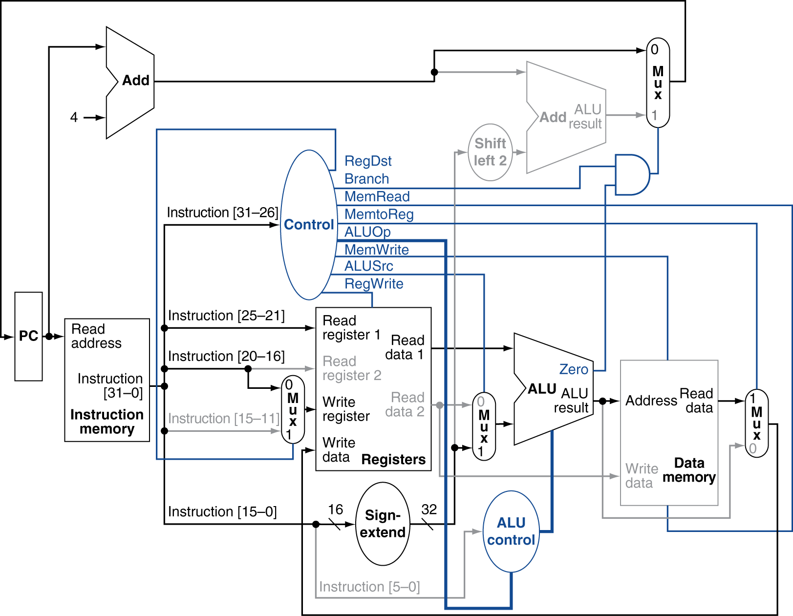
4.4 lw Instruction Execution

Slide 19
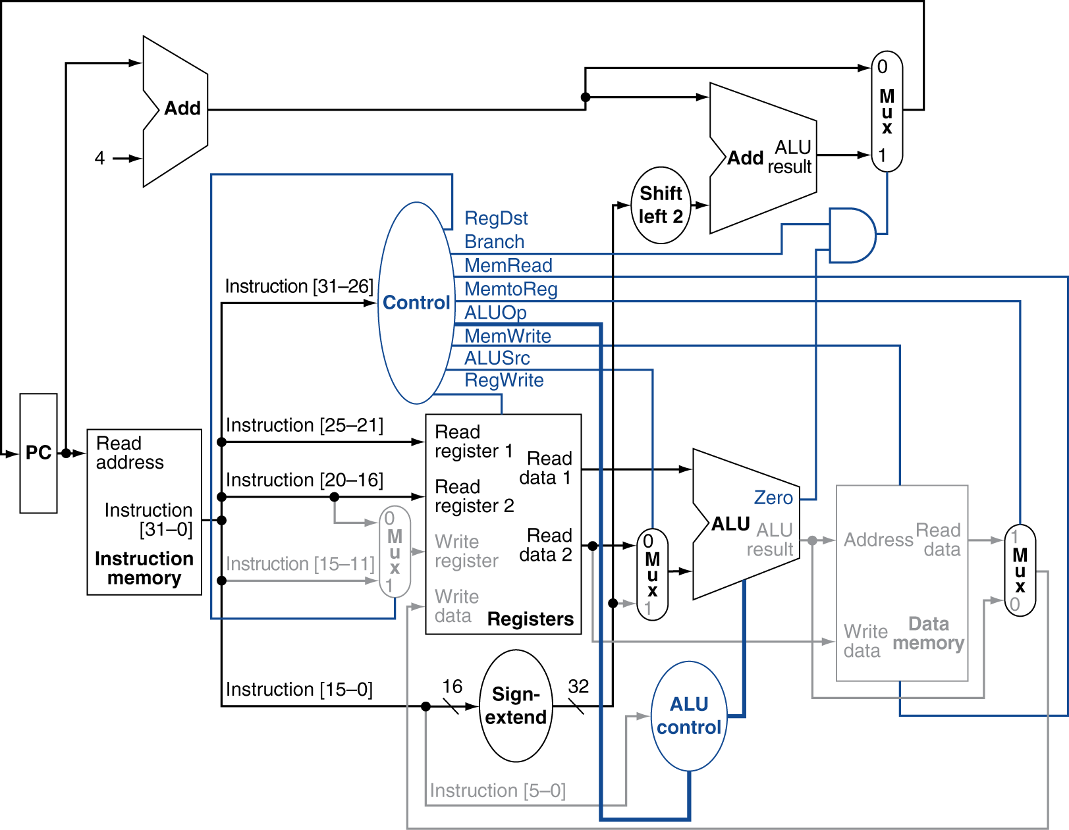
4.4 beq Instruction Execution

Slide 20
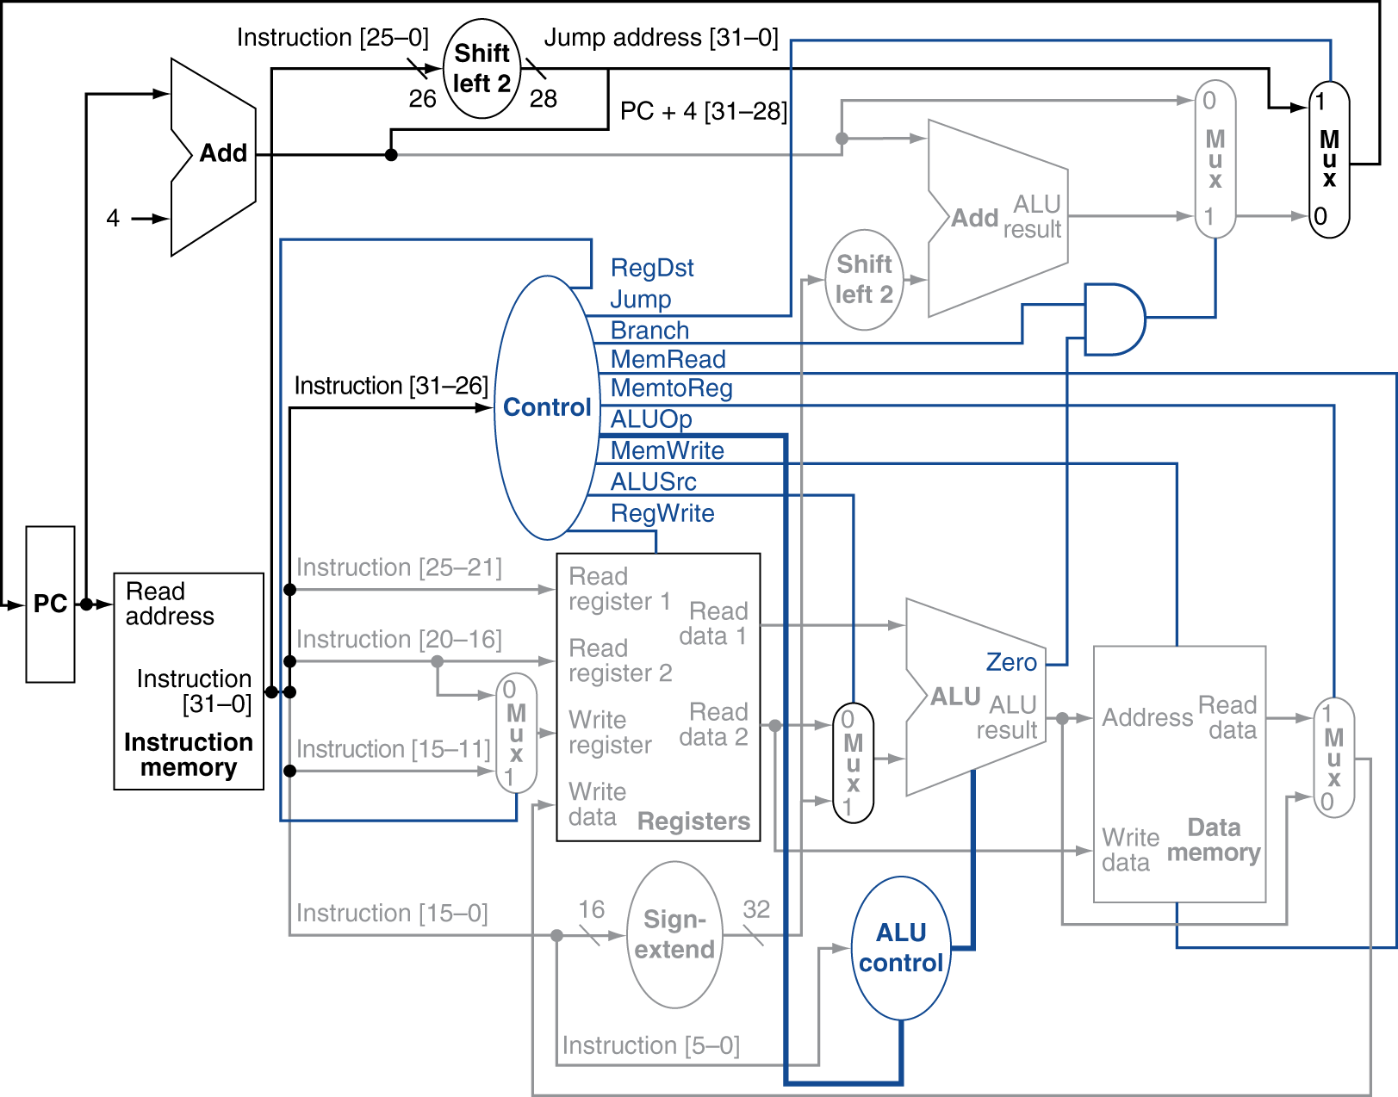
4.4 Implementing Jumps

Slide 21
4.4 R-type Instruction Timing

Slide 22
4.4 lw Instruction Timing

Slide 23
4.4 sw Instruction Timing

Slide 24
4.4 beq Instruction Timing

Slide 25
4.4 j Instruction Timing

Slide 26
4.5 An Overview of Pipelining
Pipelining is an implementation technique in which ___________ _____________are _________ in execution.
Pipelining helps _____________, not individual ___________ _____.
You can’t ____ a stage.

Slide 27
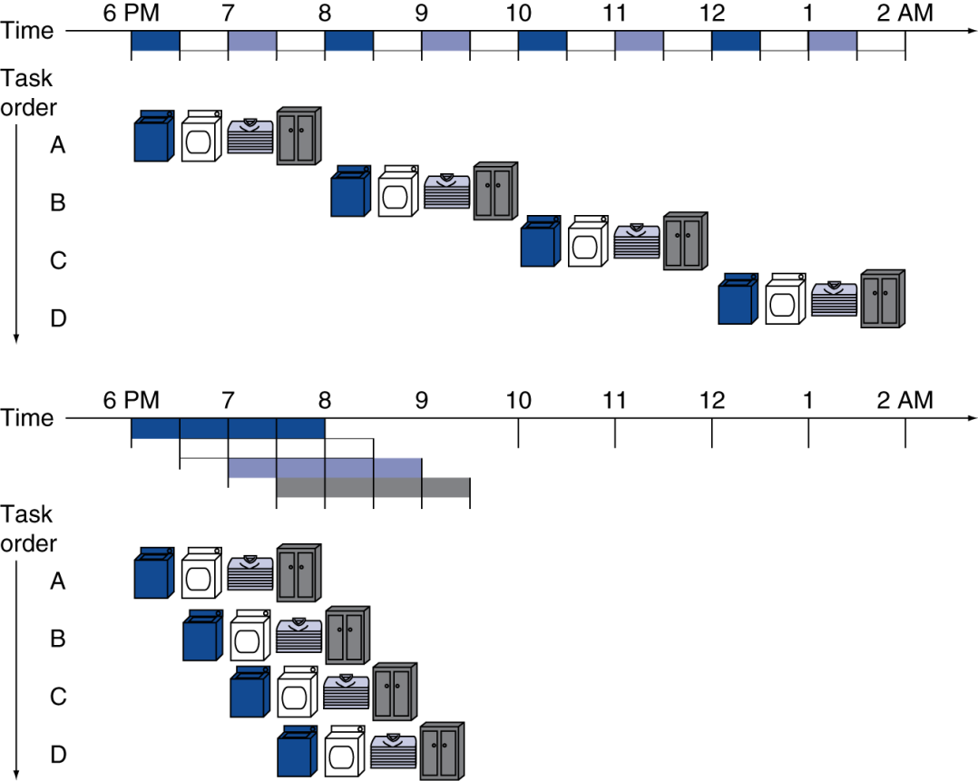
4.5 The Laundry Analogy
Speedup
One Load
Four Loads
N Loads as N → ∞

Slide 28
4.5 MIPS Processor Stages
Instruction fetch (IF)
Instruction decode and register read (ID)
Execution (calculate address) (EX)
Memory access (MEM)
Register write (WB)

Slide 29
4.5 Single Cycle vs. Pipelined Performance
Consider: lw, sw, add, sub, and, or, slt, beq
Operation times: memory, ALU 200 ps, register 100 ps
Instr | Instruction fetch | Register read | ALU op | Memory access | Register write | Total time
lw | 200ps | 100 ps | 200ps | 200ps | 100 ps | 800ps
sw | 200ps | 100 ps | 200ps | 200ps |  | 700ps
R-format | 200ps | 100 ps | 200ps |  | 100 ps | 600ps
beq | 200ps | 100 ps | 200ps |  |  | 500ps

Slide 30
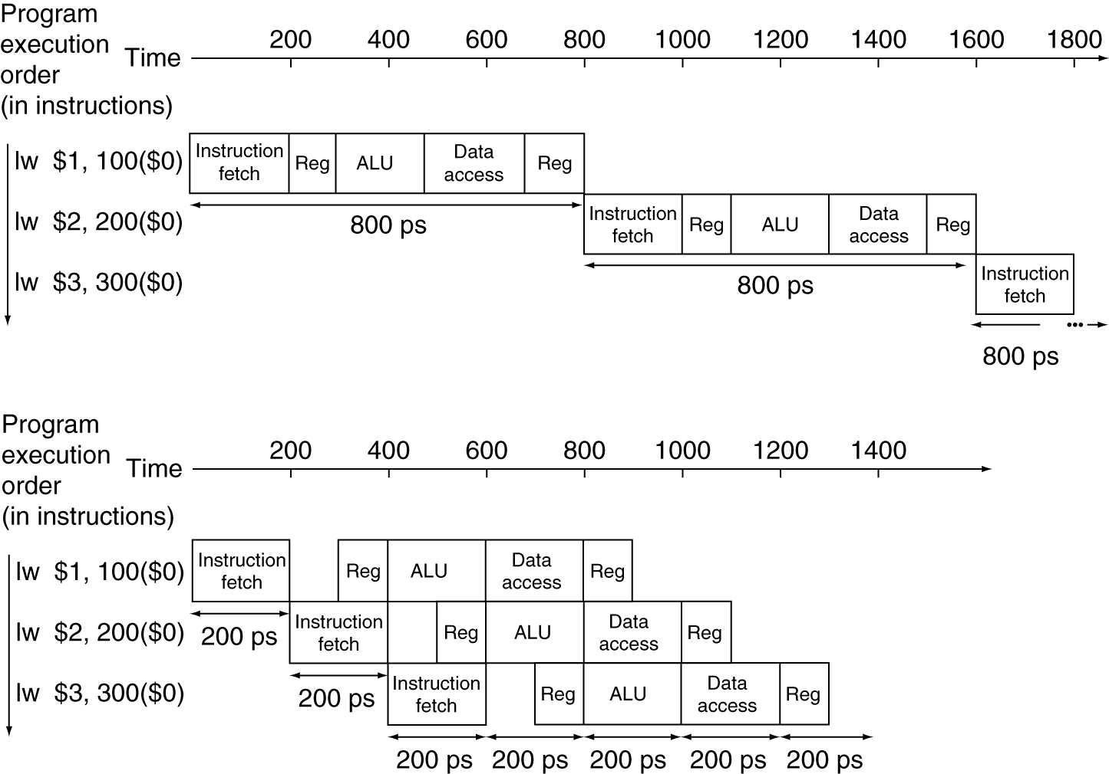
4.5 Single Cycle vs. Pipelined Timeline

Slide 31
4.5 Designing Instruction Sets for Pipelining
All MIPS instructions are the same ______.
MIPS has only a few __________ ______.
Memory operands appear only in _____.
Operands must be _______ in memory.

Slide 32
4.5 Pipeline Hazards
Structural Hazard - not enough _________.
Data Hazards – one __________ needs the ______ of another
Control Hazard – __________ aren’t made
Conservative Approach – ______
Alternative Approach – _________

Slide 33
4.5 Data Hazards
A ____ hazard occurs when a ______ _____ has not yet been ______ to the ________ ____.
Consider
add $s0, $t0, $t1
sub $t2, $s0, $t3
Though the result is not ______ until ___, it is available after the add has finished the EX stage, _______ it to the right place.

Slide 34
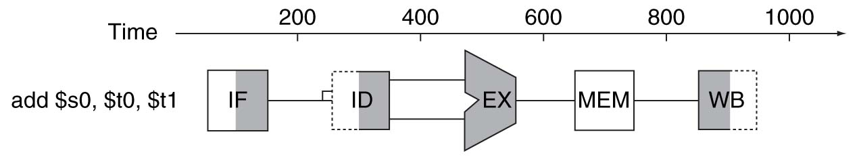
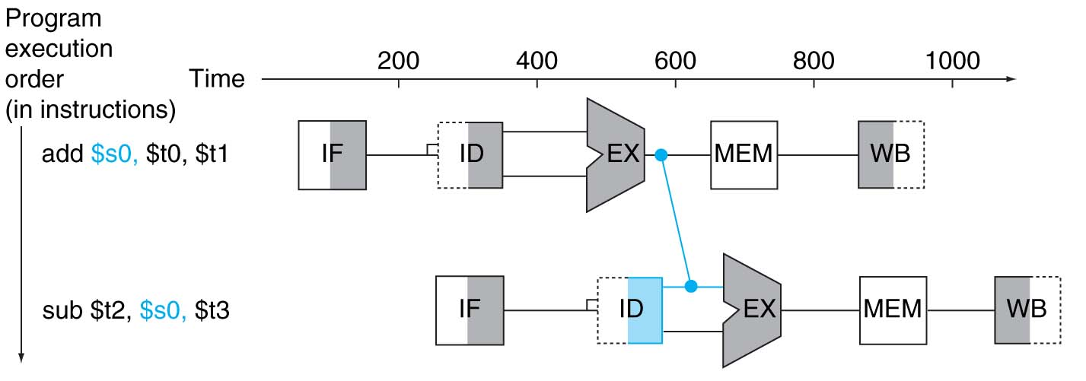
4.5 Two Instruction Forwarding
Forwarding paths are _____ only if the destination stage is _____ than the source stage.

Slide 35
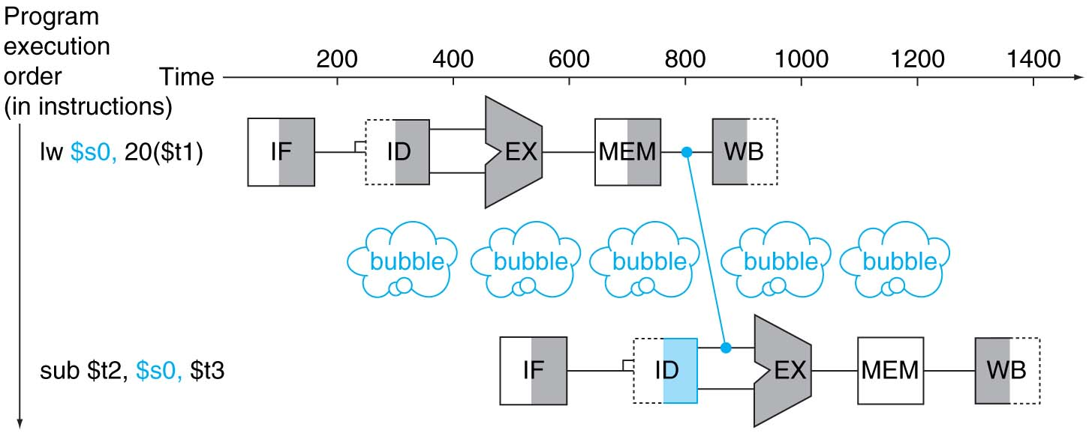
4.5 More on Forwarding
Forwarding can’t fix everything.
Consider
lw $s0, 20($t1)
sub $t2, $s0, $t3

Slide 36
4.2 The Compiler Can Help
Consider the following:
a = b + e;
c = b + f;
lw $t1, 0($t0)
lw $t2, 4($t0)
add $t3, $t1, $t2
sw $t3, 12($t0)
lw $t4, 8($t0)
add $t5, $t1, $t4
sw $t5, 16($t0)

Slide 37
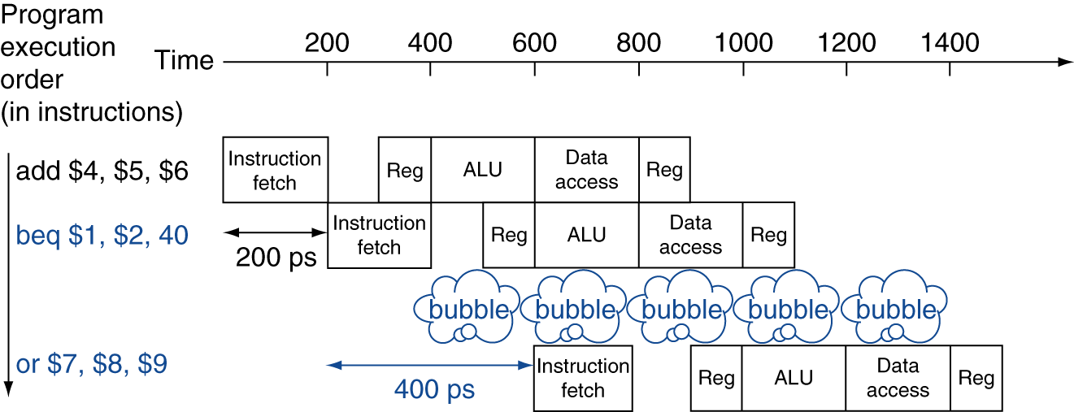
4.2 Stalling on Control Hazards
Performance of “Stall on Branch”

Slide 38
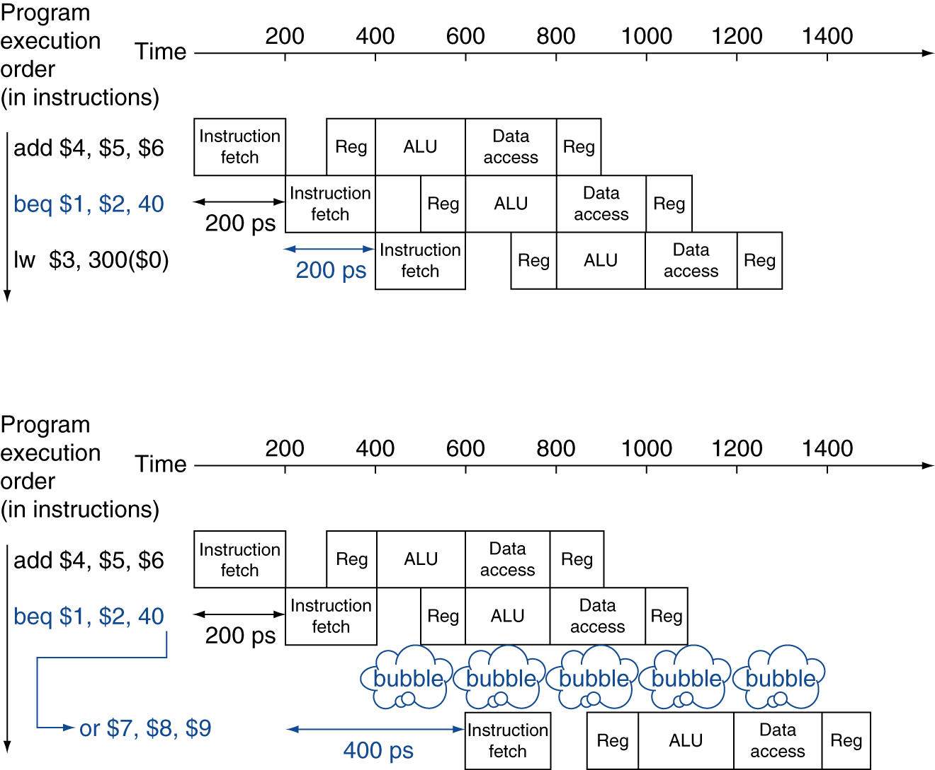
4.2 Prediction for Control Hazards

Slide 39
4.5 More Realistic Branch Prediction
______ branch prediction
Based on _______ branch behavior
Example: ____ branches
Predict _________ branches __________
Predict _________ branches ___________
________ branch prediction
_________ measures ______ branch behavior
Record _______ ________ of each branch
Assume ______ behavior will continue the trend
When _______, stall while re-fetching, and update ______

Slide 40
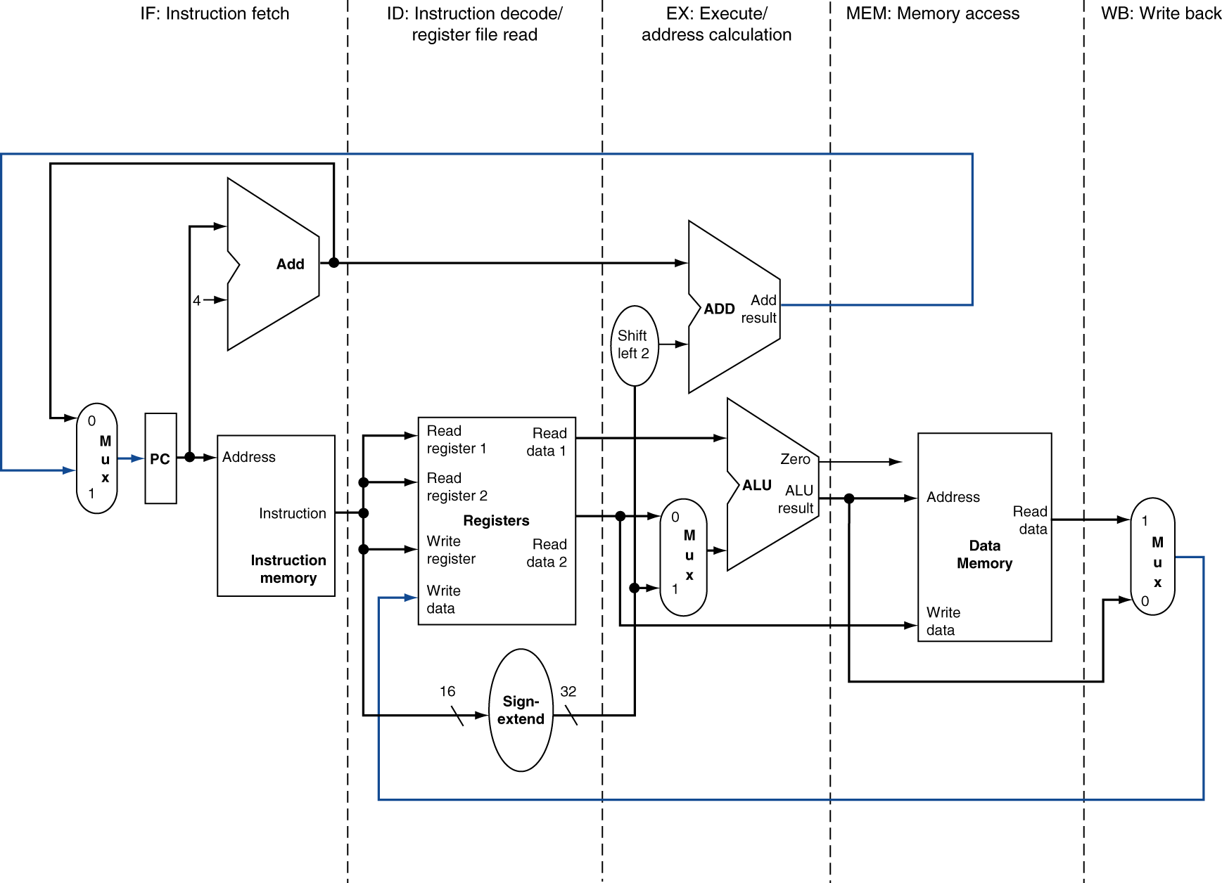
4.6 Identifying the Pipeline Stages

Slide 41
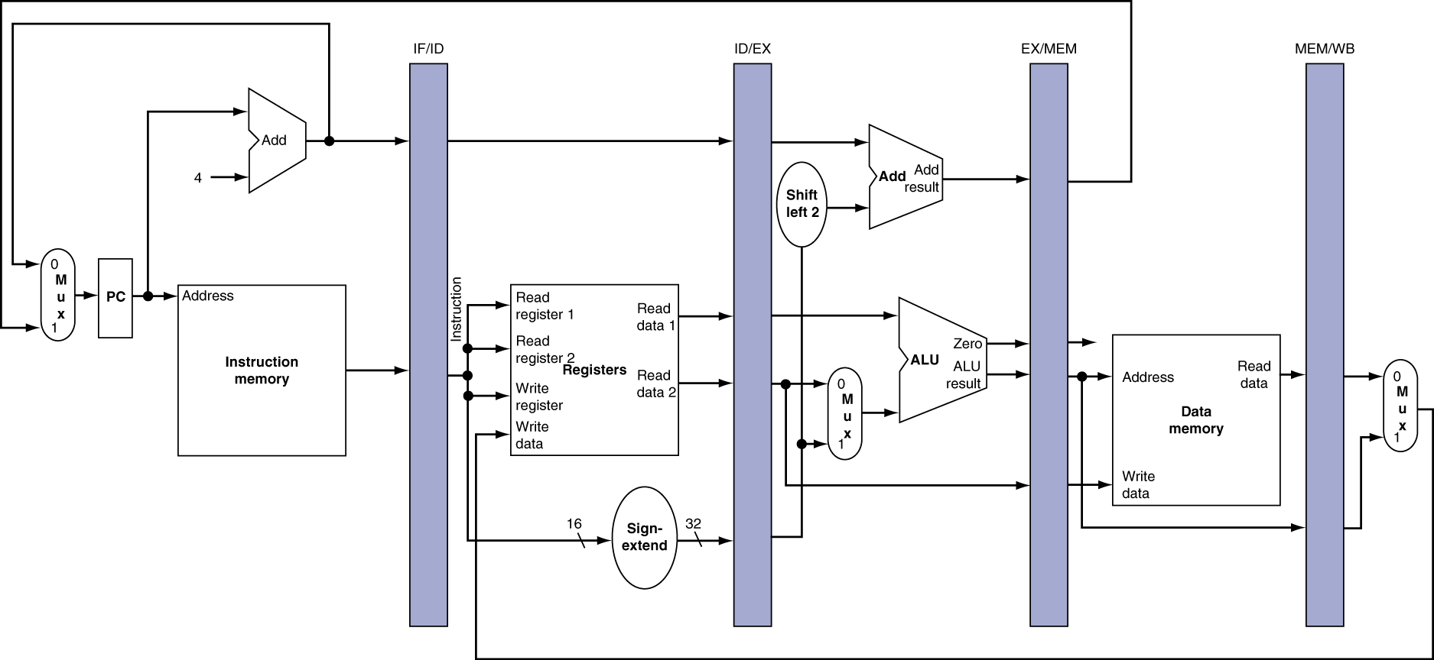
4.6 Adding Pipeline Registers

Slide 42
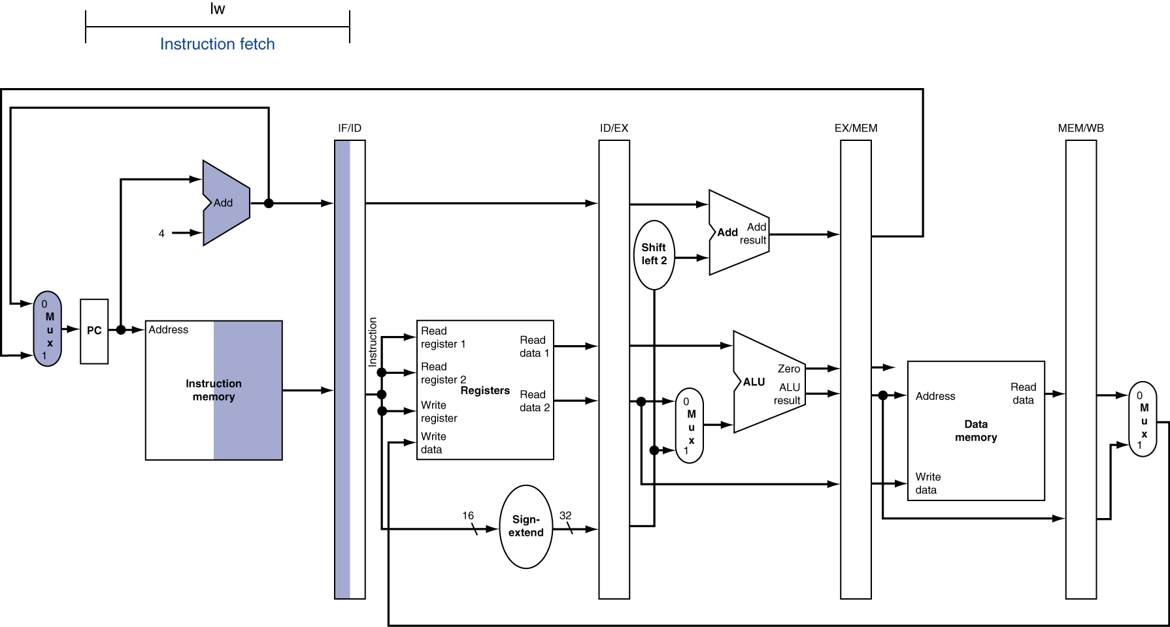
4.6 lw Instruction Execution: IF Stage

Slide 43
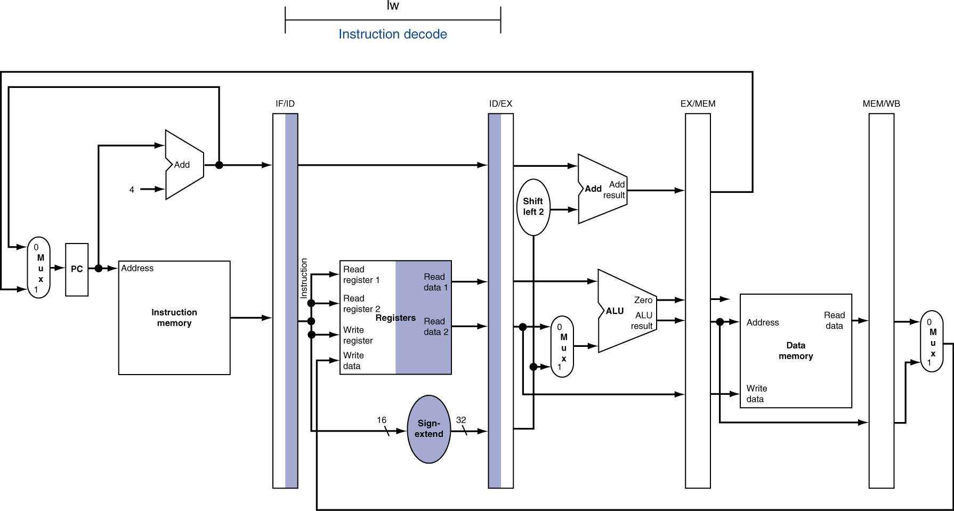
4.6 lw Instruction Execution: ID Stage

Slide 44
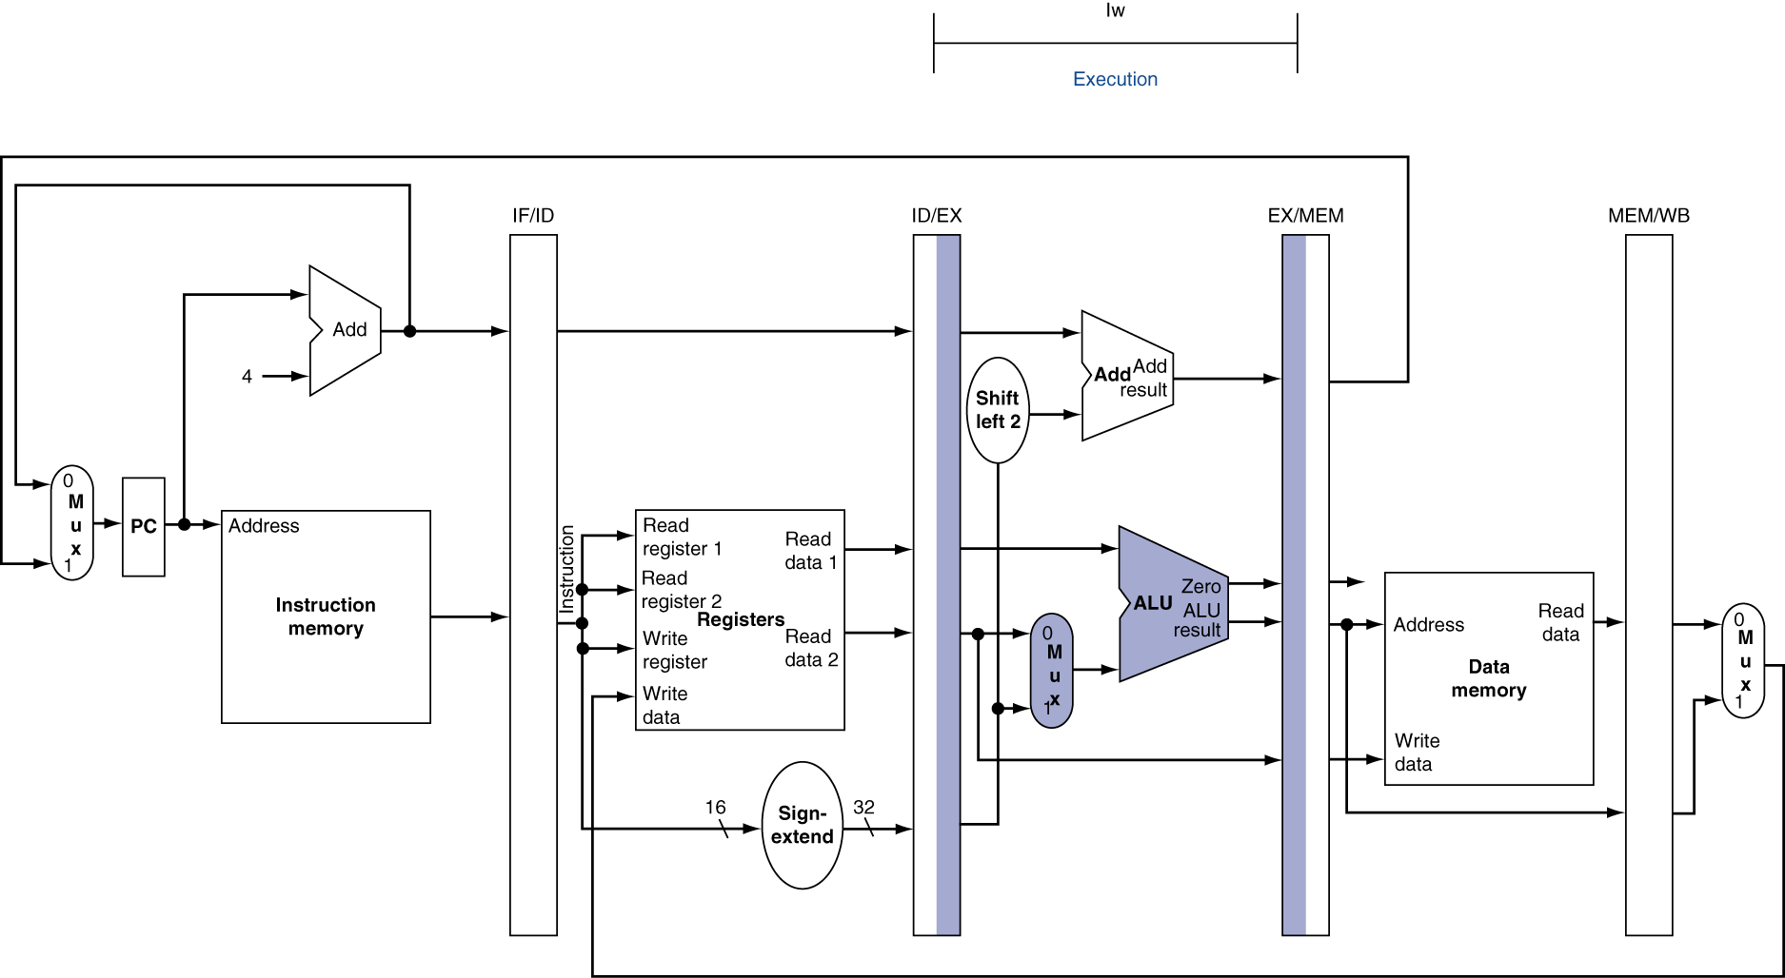
4.6 lw Instruction Execution: EX Stage

Slide 45
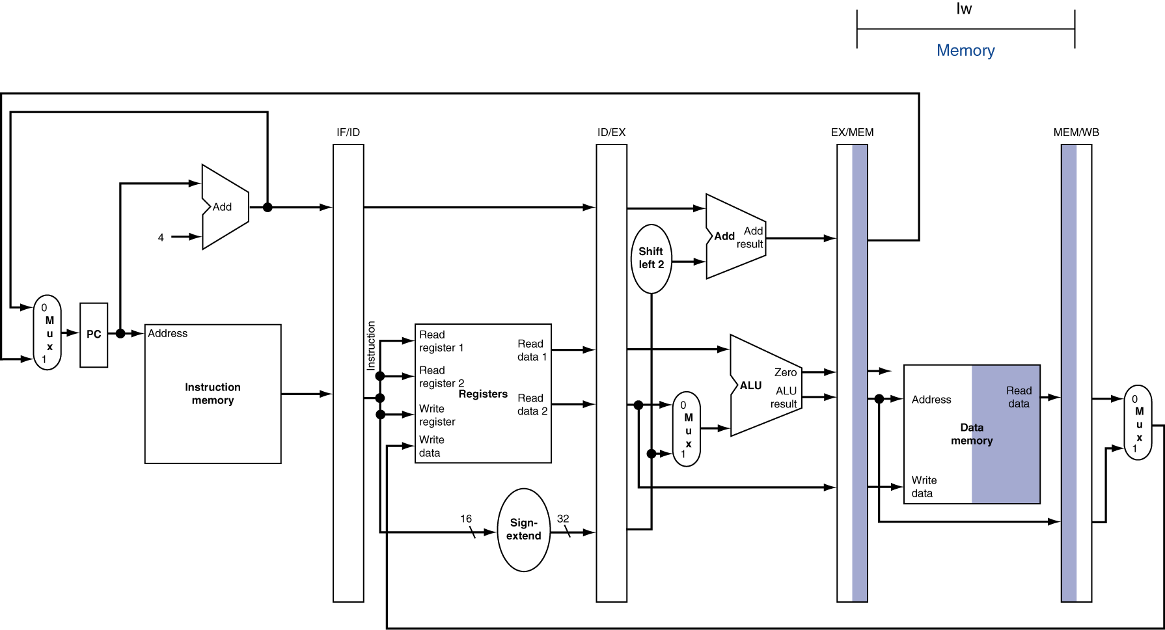
4.6 lw Instruction Execution: MEM Stage

Slide 46
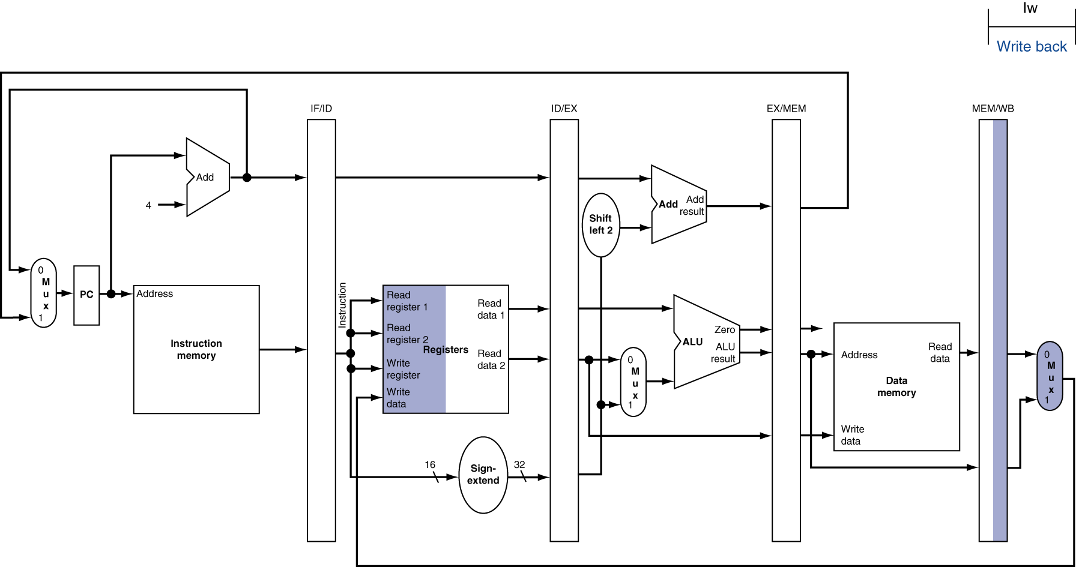
4.6 lw Instruction Execution: WB Stage

Slide 47
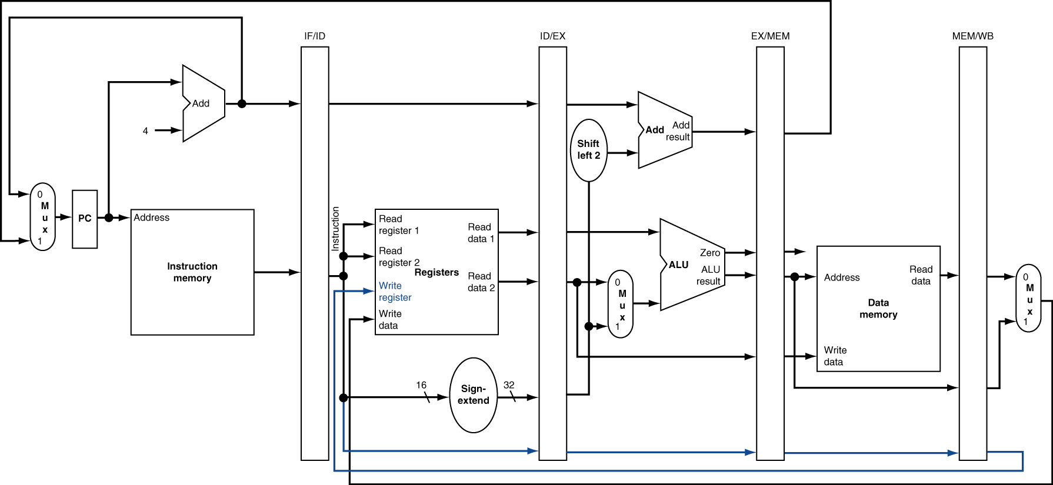
4.6 Corrected Datapath for lw

Slide 48

4.6 sw Instruction Execution: EX Stage

Slide 49
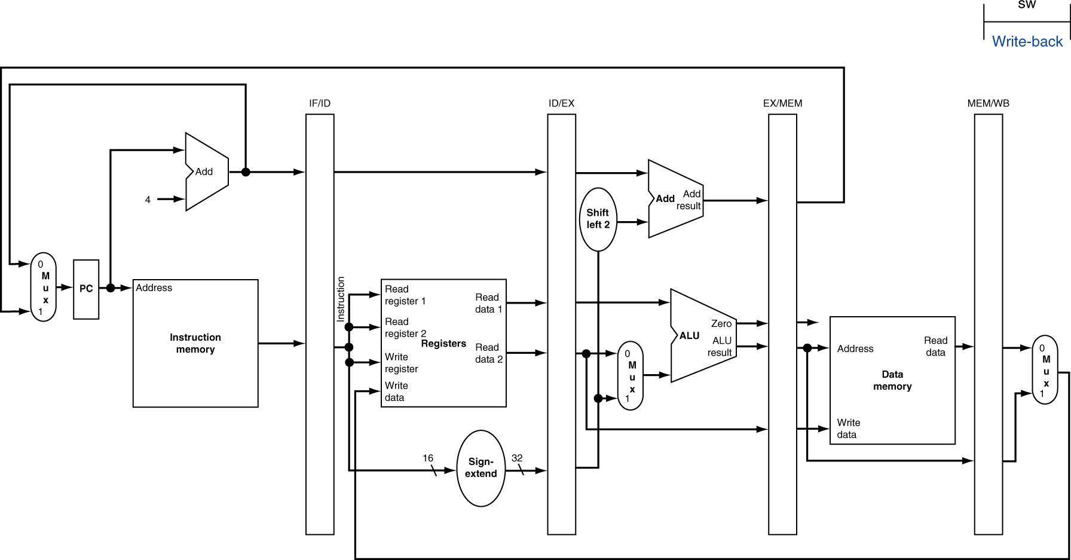
4.6 sw Instruction Execution: MEM Stage

Slide 50
4.6 sw Instruction Execution: WB Stage

Slide 51
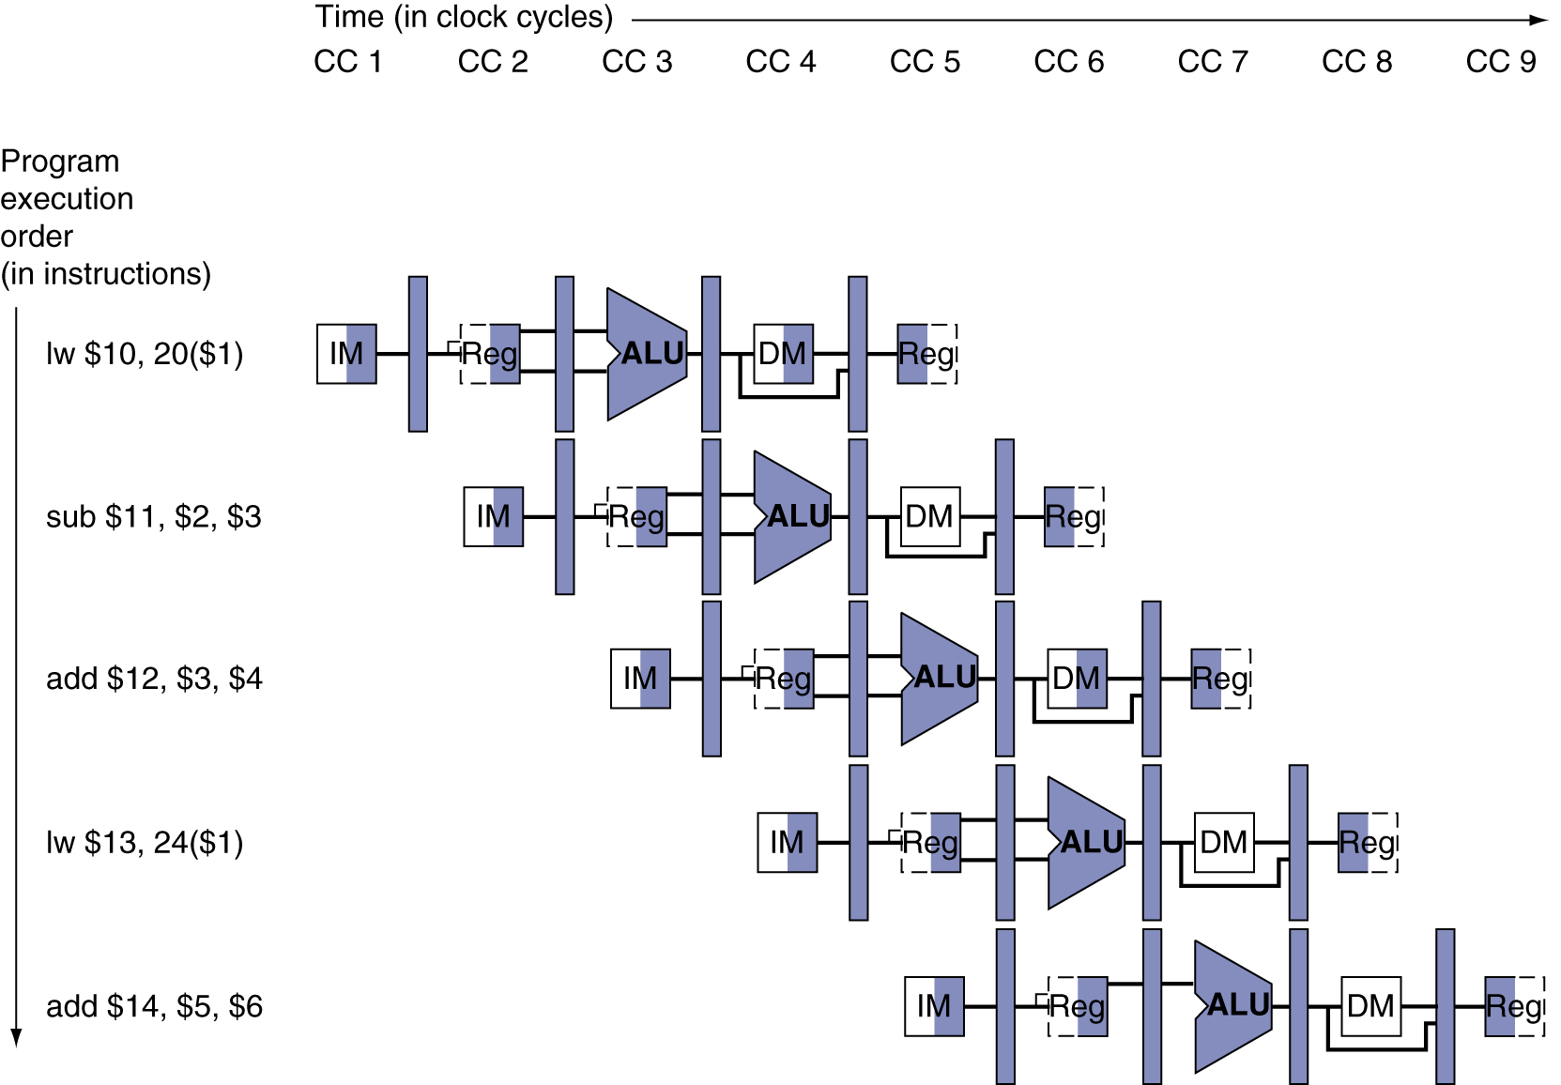
4.6 Stylized Multiple Clock Cycle Diagrams

Slide 52
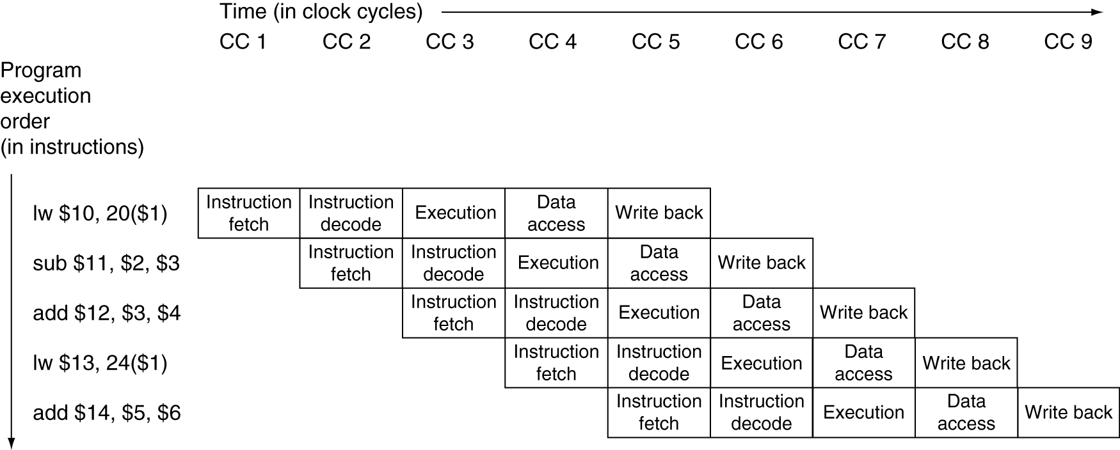
4.6 Traditional Multiple Clock Cycle Diagrams

Slide 53
4.6 Alternate Multiple Clock Cycle Diagrams
Cycle | IF | ID | EX | MEM | WB
1 | lw $10 | ahead1 | ahead2 | ahead3 | ahead4
2 | sub $11 | lw $10 | ahead1 | ahead2 | ahead3
3 | add $12 | sub $11 | lw $10 | ahead1 | ahead2
4 | lw $13 | add $12 | sub $11 | lw $10 | ahead1
5 | add $14 | lw $13 | add $12 | sub $11 | lw $10
6 | after1 | add $14 | lw $13 | add $12 | sub $11
7 | after2 | after1 | add $14 | lw $13 | add $12
8 | after3 | after2 | after1 | add $14 | lw $13
9 | after4 | after3 | after2 | after1 | add $14

Slide 54
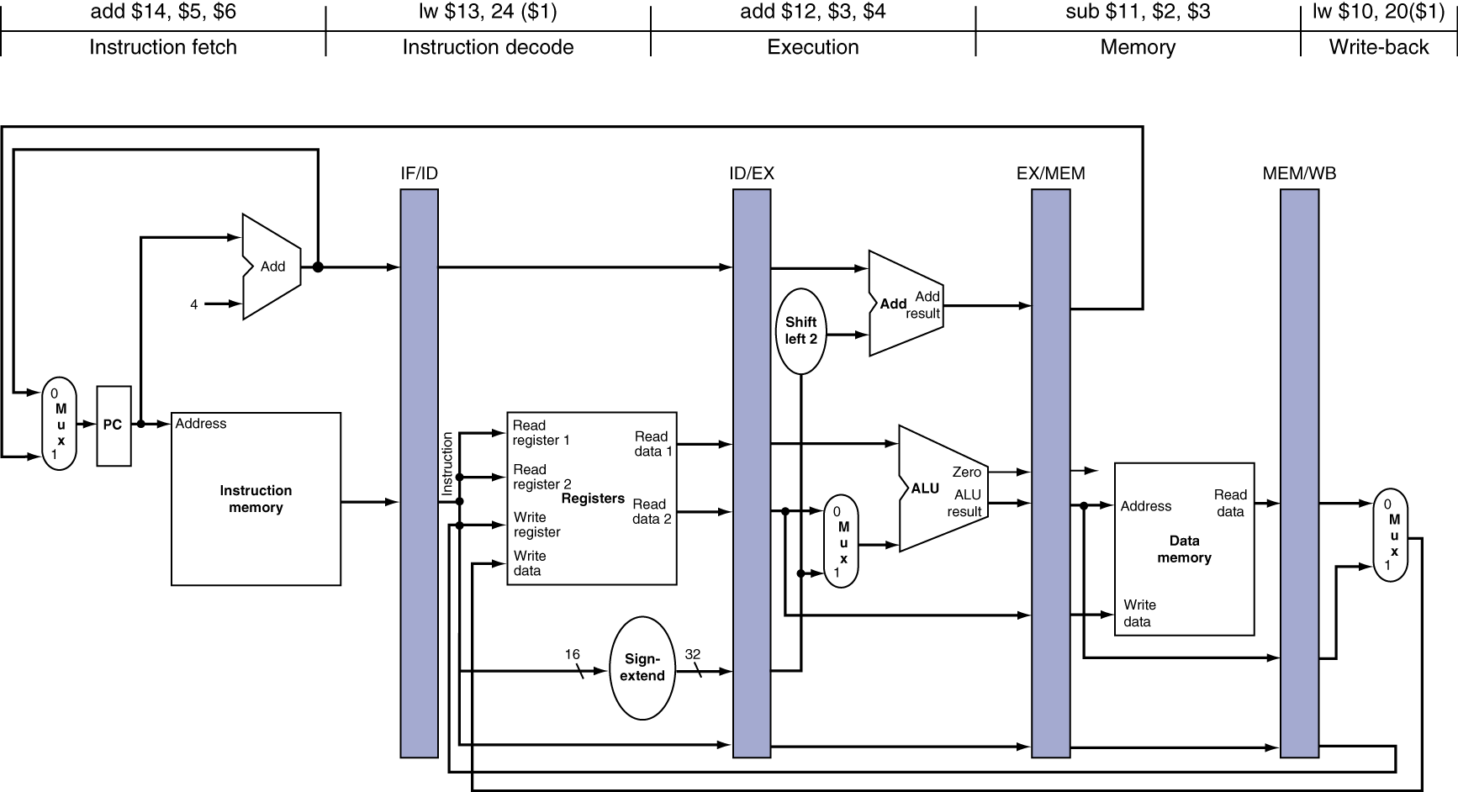
4.6 Cycle 5 Slice

Slide 55
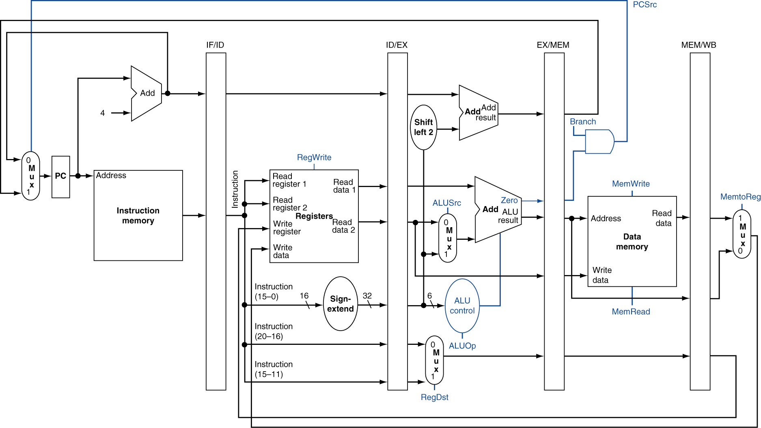
4.6 Identifying Pipelined Control Lines

Slide 56
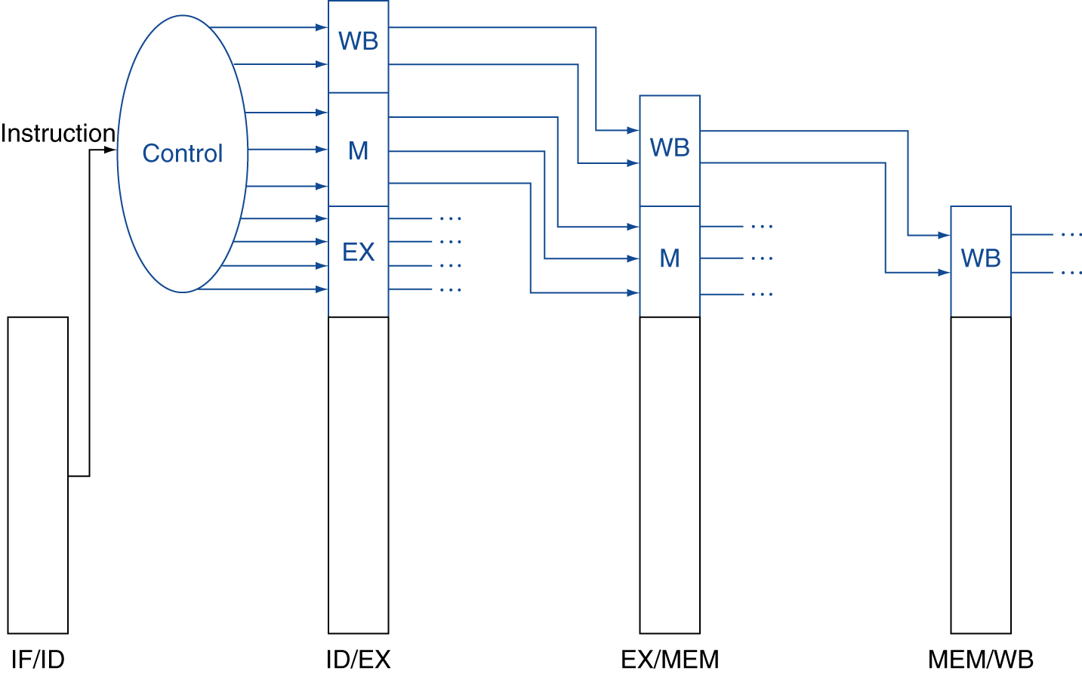
4.6 Generating and Saving Control Lines
EX
MEM
WB

Slide 57
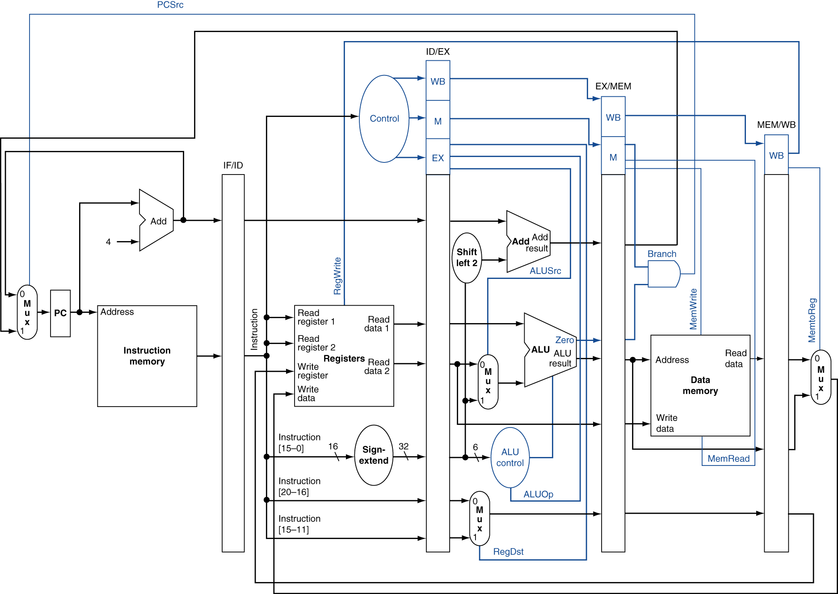
4.6 Putting it all Together

Slide 58
4.7 Data Dependencies
In the previous example, there were no data dependencies. Now, the rest of the story.
1 sub $2, $1, $3
2 and $12, $2, $5
3 or $13, $6, $2,
4 add $14, $2, $2
5 sw $15, 100($2)

Slide 59
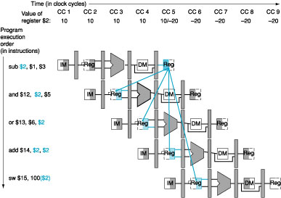
4.7 Which Data Dependencies are Hazards

Slide 60
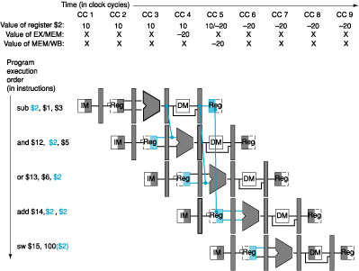
4.7 Forwarding in Action

Slide 61
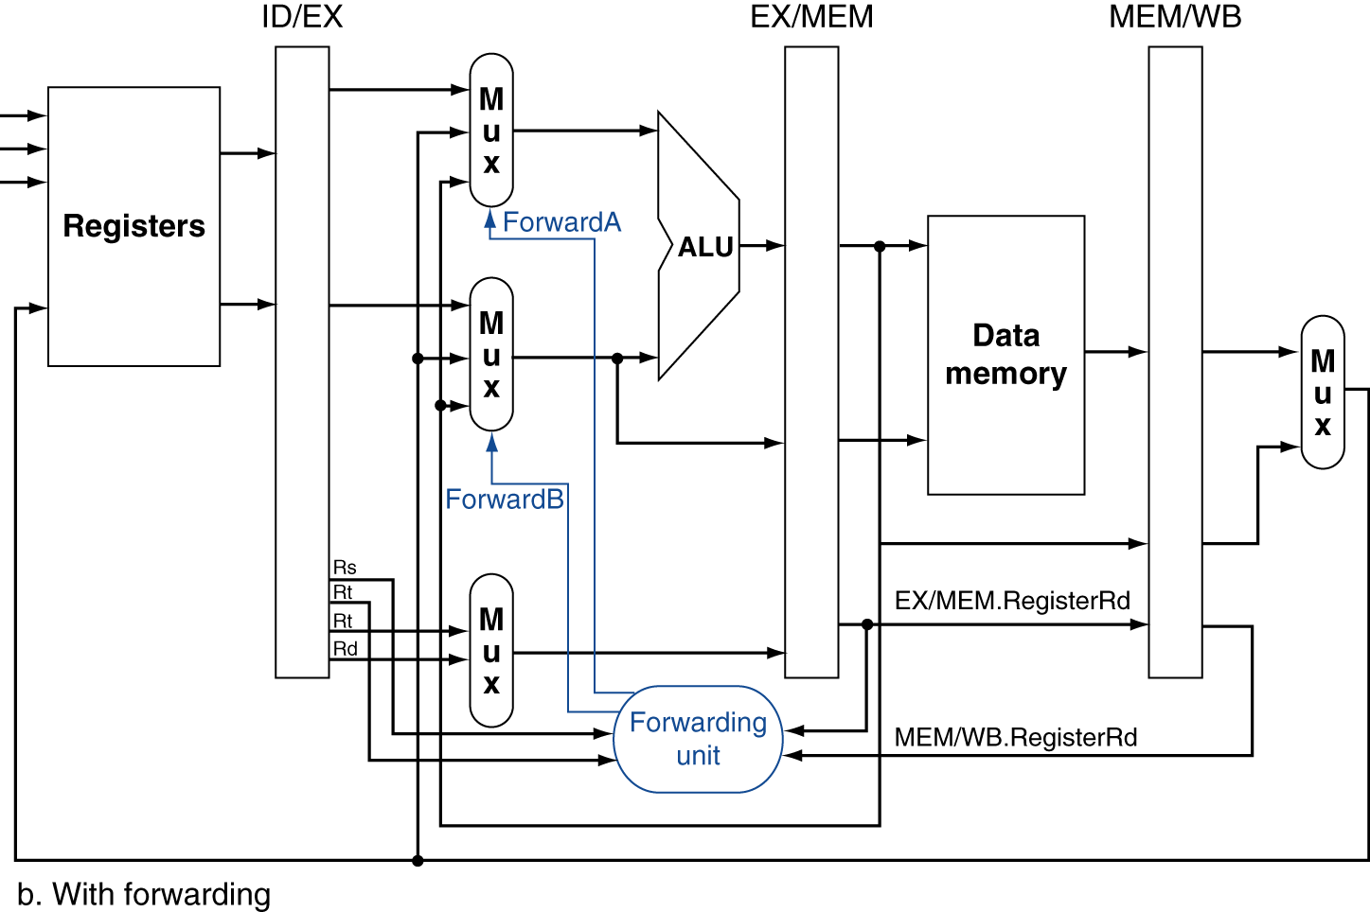
4.7 Forwarding Paths

Slide 62
4.7 Forwarding Unit: Classifying Hazards
Type 1 – The information needed in the ___ stage by an instruction is the result of the instruction ___ stage ahead (found in the ________ pipeline register)
a. The information is needed in R[rs]
b. The information is needed as R[rt]
Type 2 – The information needed in the ___ stage by an instruction is the result of the instruction ___ stages ahead (found in the ________ pipeline register)
a. The information is needed in R[rs]
b. The information is needed as R[rt]

Slide 63
4.7 Forwarding Unit: Type 1 Hazards
Type 1 Hazard
If (ahead1 writes to register and (ahead1 doesn’t have $zero as the destination register) and (ahead1 is writing to a register read by Current Instruction)) Forward from EX/MEM a) Forward to RegisterRs, b) Forward to RegisterRd
ahead1 writes to register
ahead1 doesn’t have $zero as the destination register
ahead1 is writing to a register read by Current Instruction

Slide 64
4.7 Forwarding Unit: Type 2 Hazards
Type 2 Hazard
If (ahead2 writes to register and (ahead2 doesn’t have $zero as the destination register) and (ahead2 is writing to a register read by Current Instruction)) Forward from MEM/WB a) Forward to RegisterRs, b) Forward to RegisterRd
ahead2 writes to register
ahead2 doesn’t have $zero as the destination register
ahead2 is writing to a register read by Current Instruction

Slide 65
4.7 Double Data Hazard Jeopardy
Consider
add $1, $1, $2
add $1, $1, $3
add $1, $1, $4
Type 2 Hazard
If (ahead2 writes to register and (ahead2 doesn’t have $zero as the destination register) and (ahead2 is writing to a register read by Current Instruction ) and (no Type 1 Hazard)) Forward from MEM/WB a) Forward to RegisterRs, b) Forward to RegisterRd

Slide 66
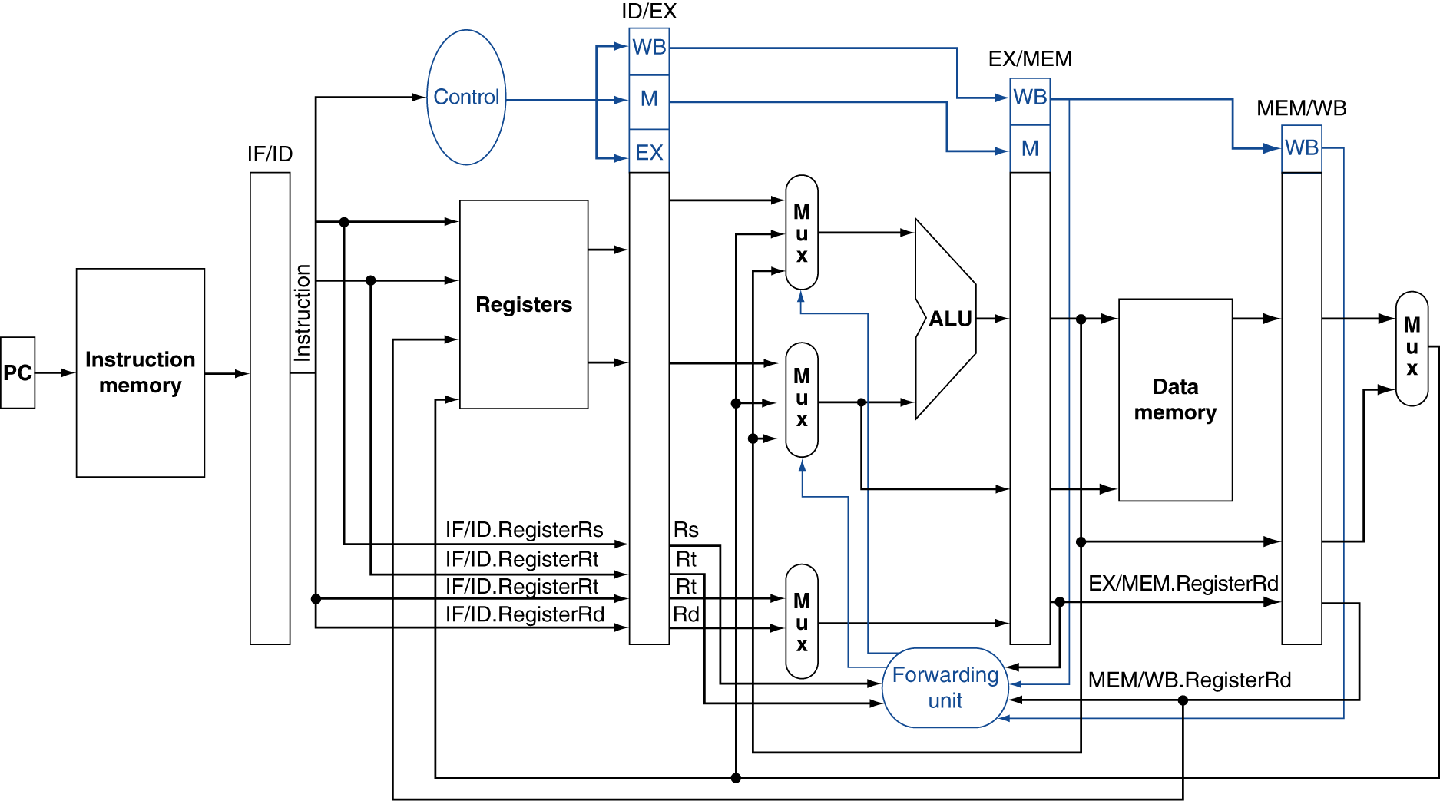
4.7 Forwarding Datapath with Control

Slide 67
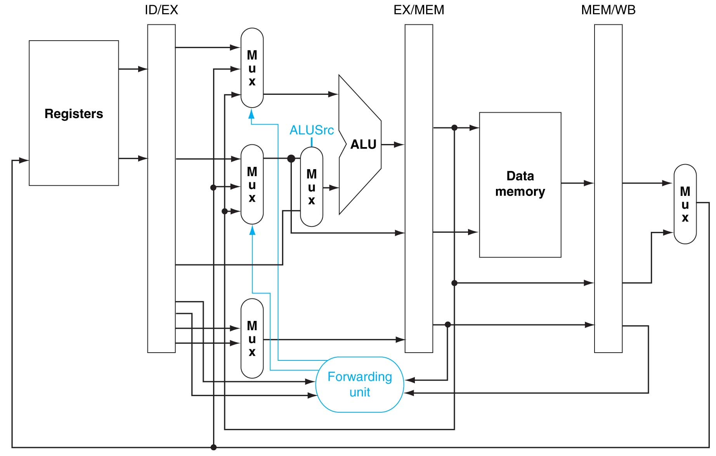
4.7 EX Forwarding Completed

Slide 68
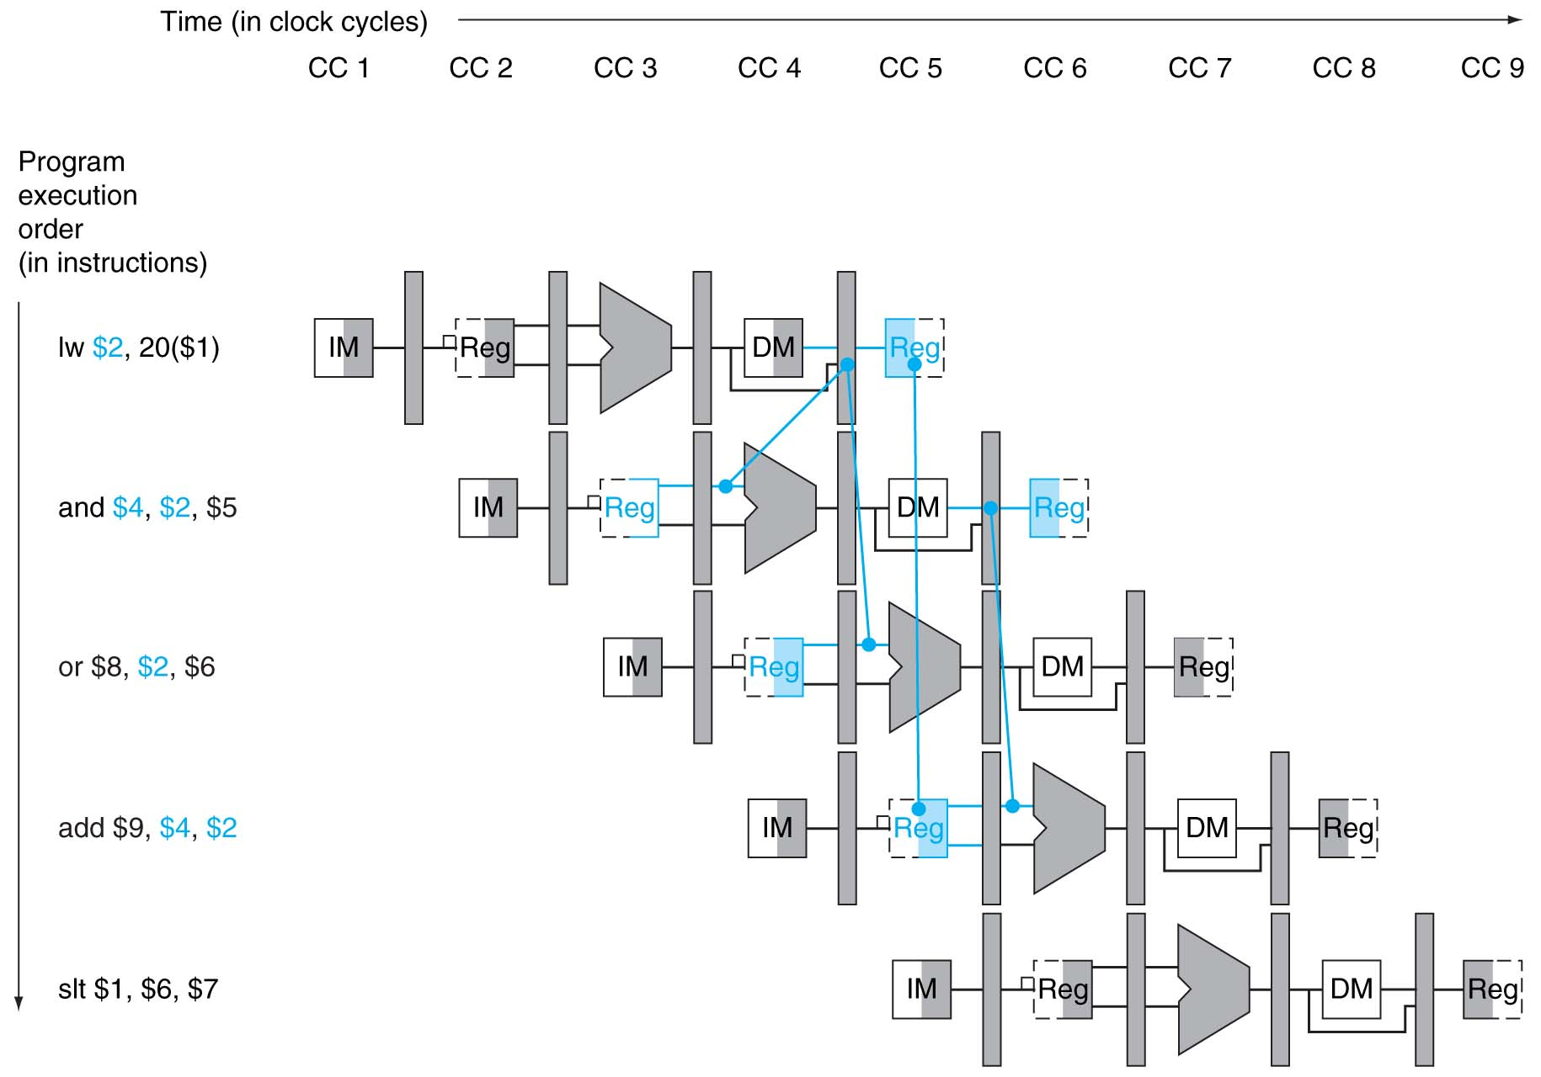
4.7 Forwarding Can’t Always Save the Day

Slide 69
4.7 Stalling in Action

Slide 70
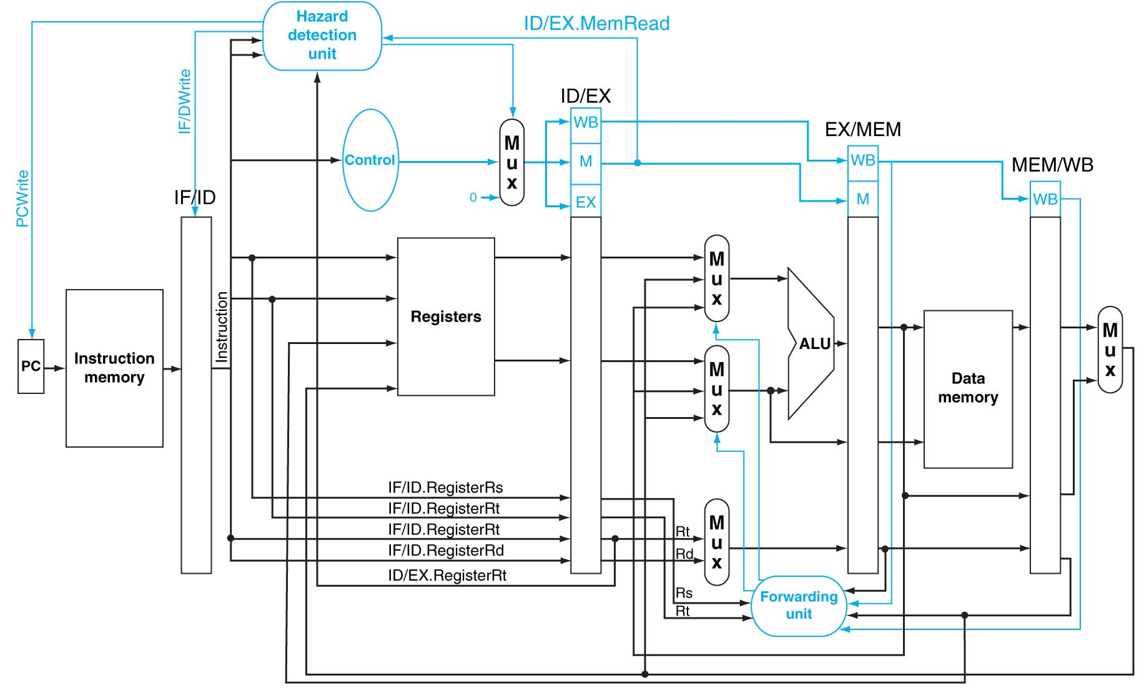
4.7 Hazard Detection Unit

Slide 71
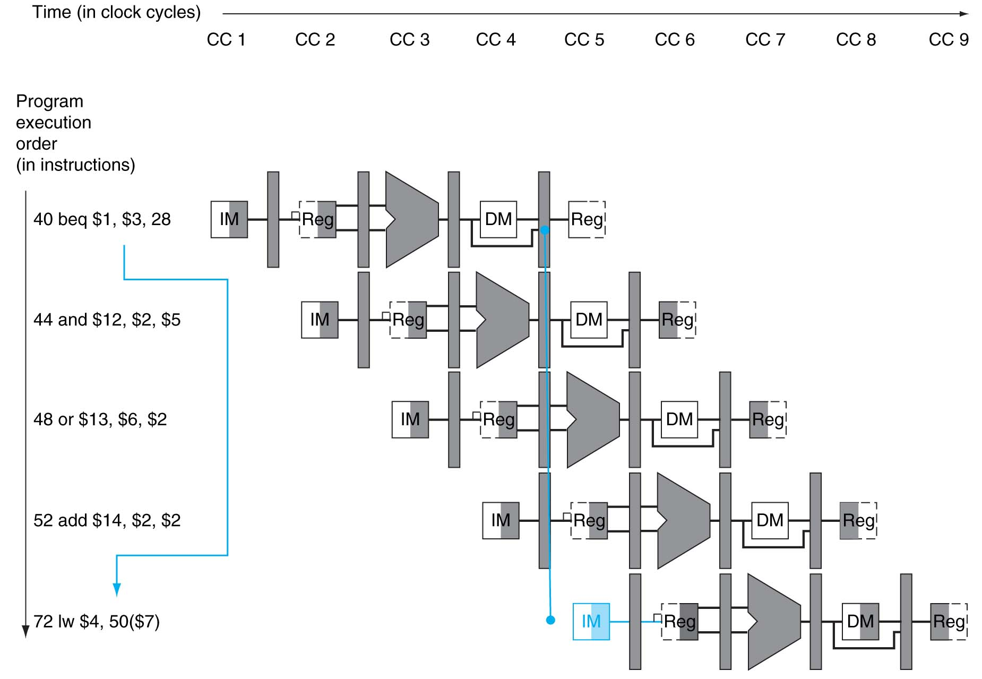
4.8 Control Hazard Example

Slide 72
4.8 Approaches to Control Hazards
Assume Branch Not Taken
________________________________________
________________________________________
Reducing the Delay of Branches – Two Items Needed
________________________________________
________________________________________
________________________________________
________________________________________

Slide 73
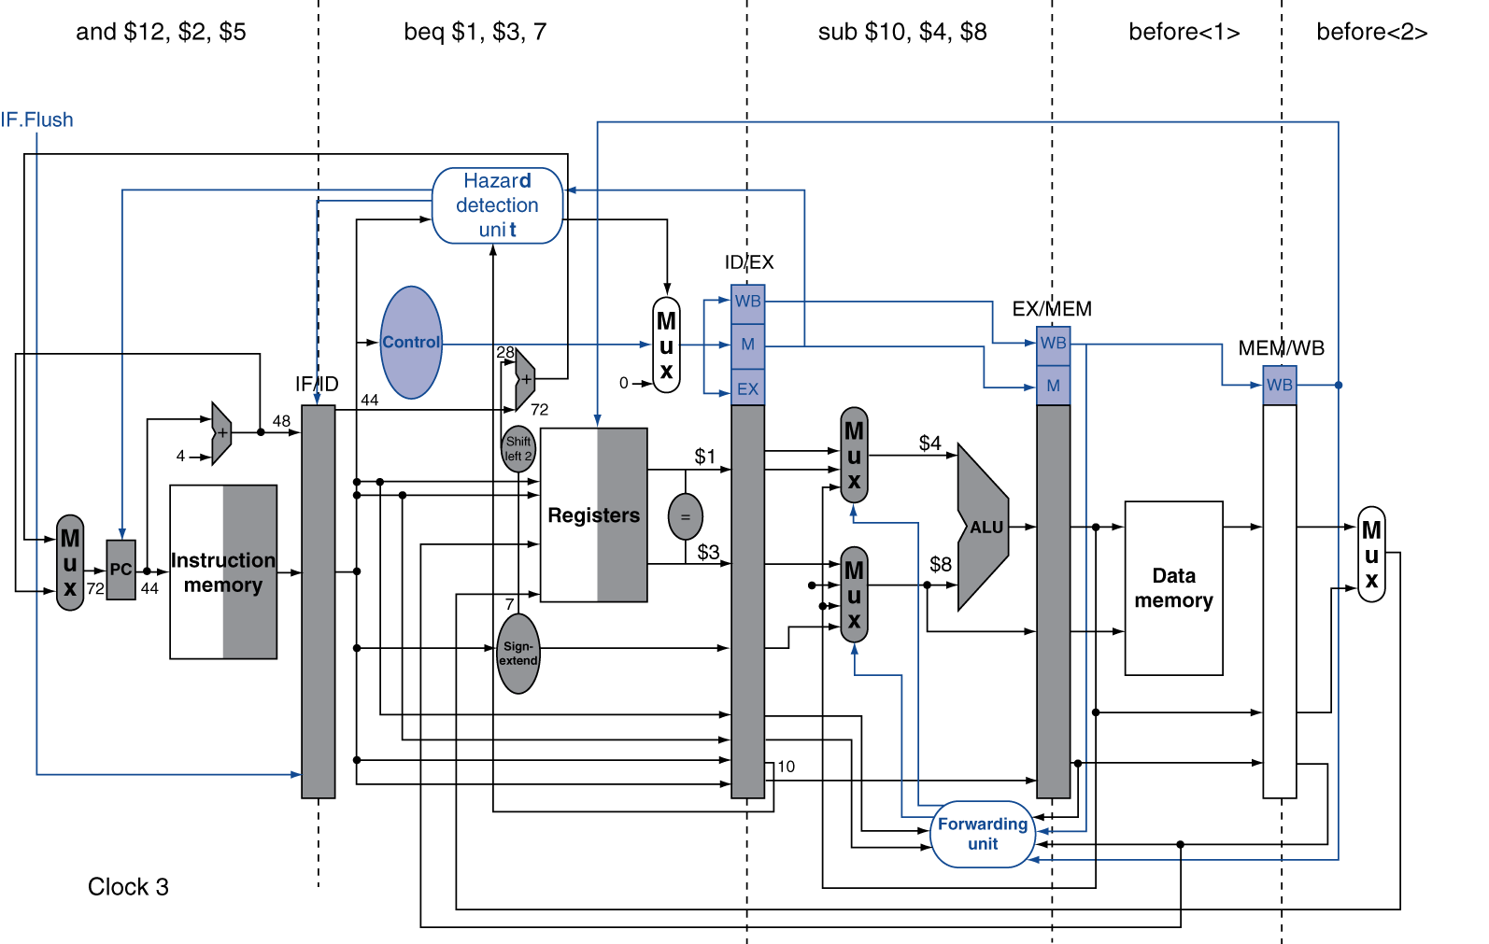
4.8 Changes to Reduce Branch Delay

Slide 74
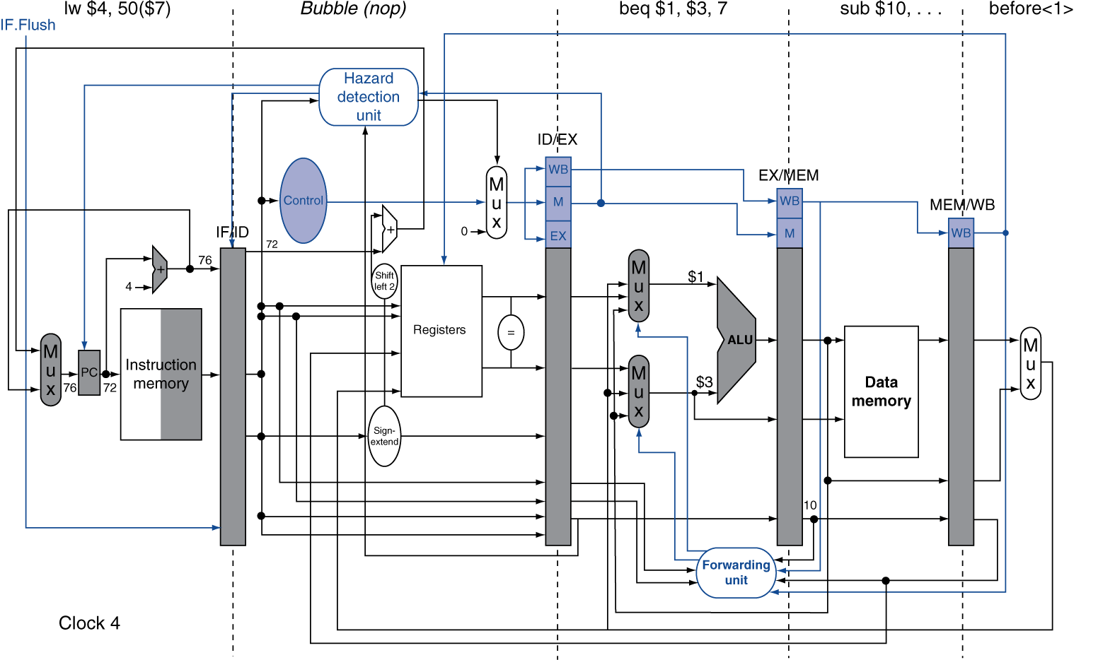
4.8 Branch Taken Example

Slide 75
4.8 Data Hazards for Branch (1)
If a ___________ register is a _____________ of 2nd or 3rd preceding ALU instruction
add $1, $2, $3
IF
ID
EX
MEM
WB
add $4, $5, $6
IF
ID
EX
MEM
WB
…
IF
ID
EX
MEM
WB
beq $1, $4, target
IF
ID
EX
MEM
WB
Can resolve using _____________

Slide 76
4.8 Data Hazards for Branches (2)
If a comparison register is a destination of ________ ALU instruction or _______________________ instruction
Need ______________
lw $1, addr
IF
ID
EX
MEM
WB
add $4, $5, $6
IF
ID
EX
MEM
WB
beq stalled
IF
ID
beq $1, $4, target
ID
EX
MEM
WB

Slide 77
4.8 Data Hazards for Branches (3)
If a comparison register is a destination of ______________ __________ _____ instruction
Need _______________-
lw $1, addr
IF
ID
EX
MEM
WB
beq stalled
IF
ID
beq stalled
ID
beq $1, $0, target
ID
EX
MEM
WB

Slide 78
4.8 Dynamic Branch Prediction
In _______ and __________ pipelines, branch ________ is more significant
Use ________ prediction
Branch _______ table
________ by _______ branch instruction addresses
Stores _______
To execute a branch
Check ________, expect the _____ outcome
Fetch from ____________
Correct if necessary and ______ table

Slide 79
4.8 Shortcoming of 1-Bit History
Mispredict as taken on ____ iteration of ______ loop
Then mispredict as not taken on _____ iteration of ______ loop _____ ______
Outer Inner Predict Actual
outer: … … inner: …
…
beq …, …, inner … beq …, …, outer
Inner loop branches mispredicted twice!
Notes:
Prediction for inner loop

Slide 80
4.9 Exceptions and Interrupts
___________ events requiring change in ______ of control
Different ISAs use the terms differently
Exception
Arises _______________, e.g., undefined opcode, overflow, syscall, …
Interrupt
From an _____________ I/O controller
Dealing with them without sacrificing performance is hard
Notes:
Prediction for inner loop

Slide 81
4.9 Handling Exceptions
In MIPS, exceptions managed by a System Control Coprocessor (CP0)
Save PC of ____________(or ____________) instruction
In MIPS: Exception Program Counter (EPC)
Save indication of the problem
In MIPS: _____ register
We’ll assume 1-bit, 0 for undefined opcode, 1 for overflow
Jump to handler at ____________

Slide 82
4.9 An Alternate Mechanism
_________ Interrupts
Handler ______ determined by the ______
Example:
Undefined opcode: C000 0000
Overflow: C000 0020
…: C000 0040
Instructions __ ___________ ____________ either
_____ _____ the interrupt, or
_______ to _____ handler

Slide 83
4.9 Handler Actions
____ _____, and transfer to ________ handler
If ______________
Take corrective action
use _____ to return to _________
Otherwise
___________ program
Report _____ using EPC, cause, …

Slide 84

4.9 Pipeline with Exceptions

Slide 85
4.9 Exception Properties
___________ exceptions
Pipeline can ____ the instruction
Handler executes, then returns to the instruction
_____________________________
PC saved in ____ register
Identifies ________ instruction
Actually _____ is saved
_______ must adjust

Slide 86
4.9 Exception Example (1)
Exception on add in
40 sub $11, $2, $4 44 and $12, $2, $5 48 or $13, $2, $6 4C add $1, $2, $1 50 slt $15, $6, $7 54 lw $16, 50($7) …
Handler
80000180 sw $25, 1000($0) 80000184 sw $26, 1004($0)

Slide 87

4.9 Exception Example (2)

Slide 88

4.9 Exception Example (3)

Slide 89
4.9 Multiple Exceptions
Pipelining _________ multiple instructions
Could have _________ exceptions __ ______
Simple approach: deal with exception from __________ instruction
Flush ___________ instructions
________ exceptions
In complex pipelines
_____________ instructions issued ___ _____
_____________ completion
Maintaining _________ exceptions is ___________!

Slide 90
4.9 Imprecise Exceptions
Just _____ pipeline and ____ ______, including exception cause(s)
Let the handler work out
______________________________
___________________________
Simplifies __________, but _____ ___________ _______ software
Not feasible for complex multiple-issue out-of-order pipelines

Slide 91
4.10 Parallelism via Instructions
Pipelining: executing multiple instructions in parallel
To increase ILP (______________________)
Deeper pipeline
Less work per stage ⇒ shorter clock cycle
Multiple _____
____________ pipeline stages ⇒ ________ pipelines
Start ________ instructions per clock cycle
CPI < 1, so use ____________________________
E.g., 4GHz 4-way multiple-issue, 16 BIPS, peak CPI = 0.25, peak ____ = 4
But _________________ reduce this in practice

Slide 92
4.10 Multiple Issue
_______ multiple issue
__________ groups instructions to be ______ together
________ them into _____ ______
___________ detects and ______ hazards
___________ multiple issue
_______ examines instruction stream and ___________ ___________ to issue _____ cycle
___________ can help by ____________ instructions
CPU ____________ hazards using advanced techniques at _________

Slide 93
4.10 Speculation
“Guess” what to do with an instruction
Start operation as soon as possible
_______ whether guess was right
If so, ________ the operation
If not, __________ and do the right thing
___________ to static and dynamic multiple issue
Examples
Speculate on branch outcome
Roll back if path taken is different
Speculate on load
Roll back if location is updated

Slide 94
4.10 Compiler/Hardware Speculation
Compiler can _________ instructions
e.g., move ______ before ___________
Can include _________ instructions to _______ from _________ guess
Hardware can ____ ______ for instructions to execute
_____ results until it determines they are _________ _______
_____ buffers on _______ speculation

Slide 95
4.10 Static Multiple Issue
_______ groups instructions into ______ _________
_______ of instructions that can be issued on a ______ cycle
Determined by ________ ________ required
Think of an _____ ______ as a very long instruction
Specifies ________ __________ operations
⇒ ______________________ (VLIW)

Slide 96
4.10 Scheduling Static Multiple Issue
Compiler must remove ________ hazards
_________ instructions into issue packets
No dependencies ______ a packet
Possibly some dependencies ________ packets
__________________; compiler must know!
Pad with _____ if necessary

Slide 97
4.10 MIPS Static Dual Issue (1)
Two-issue packets
One __________ instruction
One ___________ instruction
Instruction type | Pipeline Stages
ALU/branch | IF | ID | EX | MEM | WB
Load/store | IF | ID | EX | MEM | WB
ALU/branch |  | IF | ID | EX | MEM | WB
Load/store |  | IF | ID | EX | MEM | WB
ALU/branch |  |  | IF | ID | EX | MEM | WB
Load/store |  |  | IF | ID | EX | MEM | WB

Slide 98

4.10 MIPS Static Dual Issue (2)

Slide 99
4.10 Scheduling Example
Loop: lw $t0, 0($s1) # $t0=array element addu $t0, $t0, $s2 # add scalar in $s2 sw $t0, 0($s1) # store result addi $s1, $s1,–4 # decrement pointer bne $s1, $zero, Loop # branch $s1!=0
 | ALU/branch | Load/store | cycle
Loop: |  |  | 1
 |  |  | 2
 |  |  | 3
 |  |  | 4
IPC = 5/4 = 1.25 (c.f. peak IPC = 2)

Slide 100
4.10 Loop Unrolling (1)
Loop:

Slide 101
4.10 Loop Unrolling (2)
Loop:

Slide 102
4.10 Loop Unrolling (3)
Loop:

Slide 103
4.10 Scheduling Unrolled Loop
Replicate loop body to expose more parallelism
Reduces loop-control overhead
Use different registers per replication
Called “register renaming”
 | ALU/branch | Load/store | cycle
Loop: |  |  | 1
 |  |  | 2
 |  |  | 3
 |  |  | 4
 |  |  | 5
 |  |  | 6
 |  |  | 7
 |  |  | 8

Slide 104

4.10 Dynamically Scheduled CPU
Preserves dependencies
Hold pending operands
Results also sent to any waiting reservation stations
Reorders buffer for register writes
Can supply operands for issued instructions

Slide 105
4.10 Speculation
_________ branch and continue ________
Don’t ________ until branch ________ determined
______ speculation
Avoid load and _____ ____ delay
Predict the __________ address
Predict _________ value
Load before completing ____________ stores
________ stored values to load unit
Don’t ______ load until _____________ cleared

Slide 106
4.10 Does Multiple Issue Work?
Yes, but not as much as we’d like
Programs have real _______________ that limit ILP
Some ______________ are hard to __________
_________________
Some _____________ is hard to expose
Limited _______ ____during instruction issue
Memory delays and ________ ____________
Hard to keep pipelines ____
_____________ can help if done well

Slide 107
4.10 Power Efficiency
Complexity of dynamic scheduling and speculations requires power
Multiple simpler cores may be better
Microprocessor | Year | Clock Rate | Pipeline Stages | Issue width | Out-of-order/ Speculation | Cores | Power
i486 | 1989 | 25MHz | 5 | 1 | No | 1 | 5W
Pentium | 1993 | 66MHz | 5 | 2 | No | 1 | 10W
Pentium Pro | 1997 | 200MHz | 10 | 3 | Yes | 1 | 29W
P4 Willamette | 2001 | 2000MHz | 22 | 3 | Yes | 1 | 75W
P4 Prescott | 2004 | 3600MHz | 31 | 3 | Yes | 1 | 103W
Core | 2006 | 2930MHz | 14 | 4 | Yes | 2 | 75W
UltraSparc III | 2003 | 1950MHz | 14 | 4 | No | 1 | 90W
UltraSparc T1 | 2005 | 1200MHz | 6 | 1 | No | 8 | 70W

Slide 108

4.11 ARM Cortex A8 Pipeline

Slide 109

4.11 Core i7 Pipeline

Slide 110
4.15 Concluding Remarks
____ influences design of ________ and ______
___________ and ________influence design of ___
Pipelining improves __________ ___________ using parallelism
More ___________ completed ___ ________
_________ for each instruction ___ ________
Hazards: __________, _____, _______
Multiple issue and dynamic scheduling (ILP)
_______________ limit achievable parallelism
_____________leads to the power wall

